Slide 1
Soccer in Australia a 136-year roller-coaster ride!
Semester 2 2011
Footscray
by Ian Syson

Slide 2
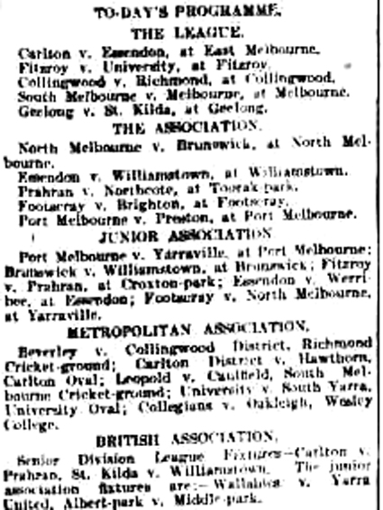
'Football' match listings, Argus 20 Aug 1910

Slide 3
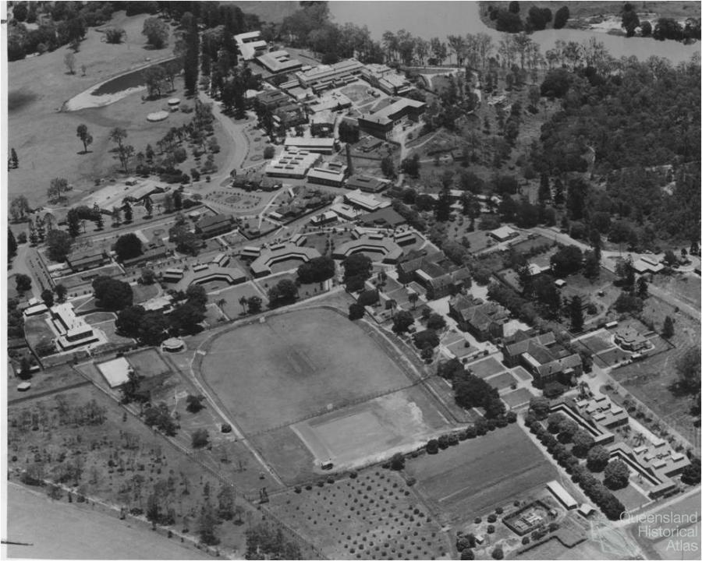
Wolston Park Hospital Cricket Ground. Likely site of the first recorded game of soccer in Australia

Slide 4
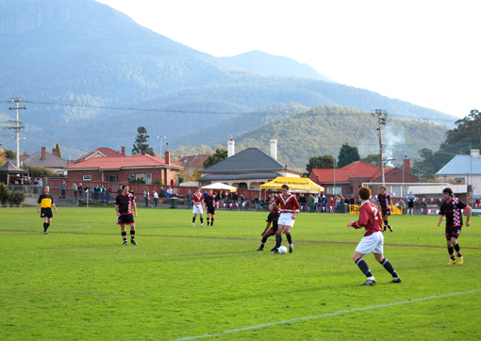
South Hobart v. Glenorchy Knights, Washington St, S. Hobart 2010.

Slide 5

Headline in the Truth, 7 Nov 1964

Slide 6


