Slide 1
ACL 2009
The Literary Politics of Gender
Lecture, Week Nine
Pamela Niehoff

Slide 2
The Struggle for the Australian Story
Conventional histories once had it that in the late 1800s two master narratives were tussling for control of the Australian story:
Nation - Australia was coming together as a nation independent of Britain and any other country.
Class - what was emerging in Australia was a society in which the working class was acknowledged as the primary and most significant class.
Yet there was a third, hidden narrative of sex and gender and the clash between masculine and feminine perspectives. This perspective or discourse was defeated but not lost and remains in the archive.
Marilyn Lake and Kay Schaffer's arguments contribute to our understanding of this third current.

Slide 3
Nation
In his poem ‘Freedom on the Wallaby’ (1891) Henry Lawson told us that we Australians had established a “garden full of promise” and that outsiders (“old greed”) were coming to take it from us.
These outsiders were:
The British – the complaints against these were legitimate to the extent that British capital was the driver of the greed.
Also, The Chinese/Asian – these complaints were possibly supported by legitimate fears but were ultimately racist.
While the ideal national subject might have been thought of in universalist terms, the realities were that he was a white, native-born Australian bushman.
So we can see how women are omitted from this concept of nationhood, and are viewed as a threat to the emerging idea of the free Australian man.

Slide 4
Class
Much of the oppositional discourse oscillated around the duality of class and nation – as opposed to individual and empire.
In his ironically titled novel The Workingman's Paradise (1892), William Lane drew a picture of an Australia spoiled by class oppression. The state and its various arms (police, army, law courts, education system) supported capital and its exploitation of the working masses.
The Workingman's Paradise was of course in league with the great nationalist tradition insofar as the noble bushman/bush worker stands as the ideal man.
It was also in league with the nastier side of the great nationalist tradition insomuch as it contained some racist views of the Chinese.

Slide 5
The place of women in an emerging nation
Lake’s first point is that there is a gender blindness in discourses such as history, and she argues that “just as women’s history cannot be fruitfully written without reference to men, neither can men’s history be properly written without reference to men’s relations with women” (1).
White women and aboriginal women did not fare well in the construction of the ideal national character.
The Bulletin was particularly vitriolic in its attack on those who were not happy with the status quo:
Two married women and a dog were struck by lightening recently at Dubbo. Half the married men have been trying to get their wives to walk about the vicinity ever since. The dogs are kept tied up. (qtd. in Lake p.4)

Slide 6
The place of women in an emerging nation
Domestic violence, abandonment and promiscuity were commonplace, and romanticised as men’s libertarianism.
“Denied access to a living wage on the assumption that they were supported by men, women were thus forced into relations of dependence” (Lake, p.7).
Feminists who gained a voice as part of the women’s suffrage movement in Australia were “mocked, abused and insulted. They were ‘officious busybodies’ and ‘leathery social interferists’. When a woman became interested in political rights she became ‘hoarse and hysterical’’’ (Lake, p.12).
She neglects her hair, and allows her stockings to fall into holes; she wears her hat with a sort of reckless abandon, and takes no more pride in complexion pastes and remedies for wrinkles, warts and outstanding freckles
(Bull-Ant 1891 qtd. in Lake p.12).

Slide 7
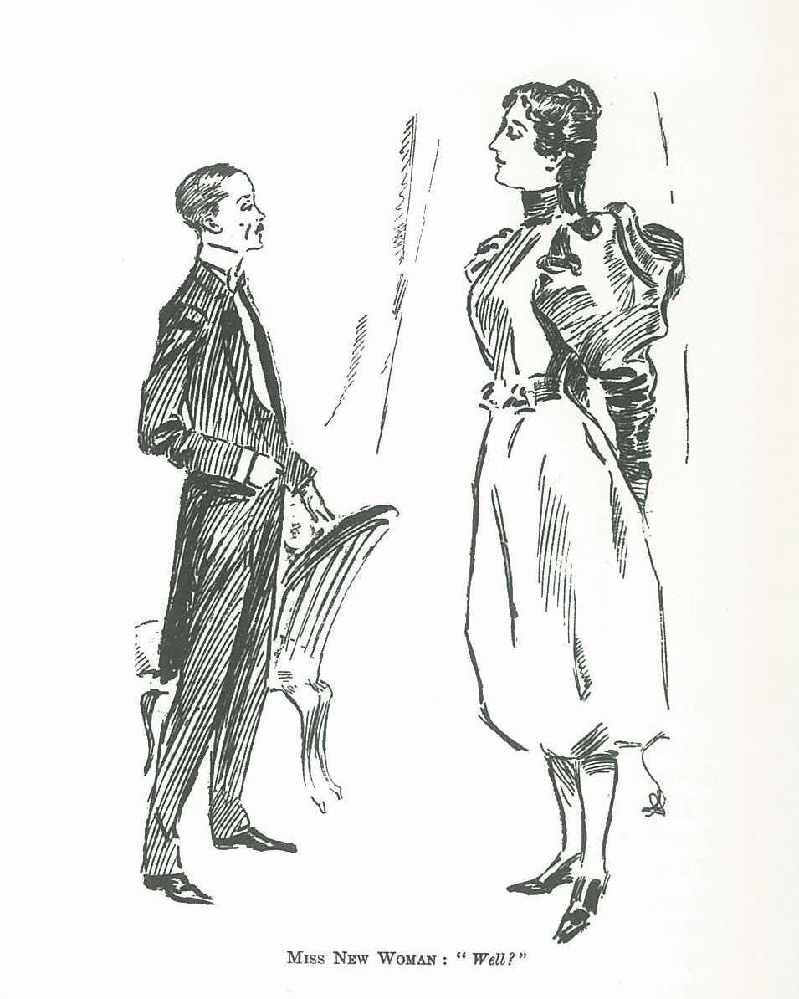
Miss New Woman, Bulletin, 15 February 1896

Slide 8
Sex and Gender
Sometimes it is hard to understand exactly what is meant by the term "gender", and how it differs from the closely related term "sex".
"Sex" refers to the biological and physiological characteristics that define men and women.
"Gender" refers to the socially constructed roles, behaviours, activities, and attributes that a given society considers appropriate for men and women.
To put it another way:
"Male" and "female" are sex categories, while "masculine" and "feminine" are gender categories.

Slide 9
Sex
Aspects of sex will not vary substantially between different human societies, while aspects of gender may vary greatly.
Some examples of sex characteristics :
Women can give birth while men cannot
Men have testicles while women do not
Women have developed breasts that are usually capable of lactating, while men do not
Men generally have more massive bones than women

Slide 10
Gender
Some examples of gender characteristics :
In Australia (and most other countries), women earn significantly less money than men for similar work
In Vietnam, many more men than women smoke, as female smoking has not traditionally been considered appropriate
In most of the world, women do more housework than men
www.who.int/gender/whatisgender

Slide 11
Gender Discrimination
Biological sex being a relatively stable given means that political oppression based on simple sexual difference stands out as unjust, cruel and oppressive. If for example it was decided that all people with testicles should be paid half of what people without testicles were paid for the same job there would be justifiable outrage.
Yet something of this kind happens the world over, justified by the subtle constructions loaded into gender categories. Thus: women are paid less because constructions of their gender render them as:
less capable
less intelligent
weaker and of lower stamina and more prone to illness
less reliable
more emotionally needy

Slide 12
Gender Discrimination
Women are not paid less because of their biological differences to men. They're paid less because the people with these physical characteristics are deemed by culture to be of lesser economic value.
A whole series of social rewards, benefits and responsibilities (ie power) are therefore distributed according to what are contingent and historically changing assumptions about male and female characteristics.
Gender politics then are movements and actions designed to continue or disrupt constructions of gender in order to impact on the way power is distributed.

Slide 13
Gender Politics in Australia Today
As feminist author Anne Summers recently pointed out, despite the fact that women outnumber “male graduates in most faculties, this is not reflected in women's overall workforce participation rate. This June it was 58.7 per cent, compared with 72.1 per cent for men” (2010)
Summers also points out that “when it comes to women aged 25 to 44, the prime child-bearing years, Australia has the second-lowest participation rate in the entire OECD, according to a Productivity Commission report in 2006.”

Slide 14
The Literary Politics of Gender
There are two aspects to the literary politics of gender.
The first is an industrial question: who gets to write, publish, review in the literary world? How is the literary public sphere organised politically? Who holds the powerful positions; who does the donkey work?
The answer is predictable. Men hold power; women represent the bottom layer of the literature industry as lowly paid workers and consumers. But there have been times in the history of literature where its dominant practitioners have been women. There are periods in Australian history when women writers at least achieved equality of presence and the 1930s and the 1980s are two such moments.

Slide 15
The Literary Politics of Gender
The second aspect of the literary politics of gender refers to the way gender is played out in literary texts and practices. It refers to the way gender is represented, constructed and critiqued in literary and critical texts.
How has gender been represented in the texts you’ve read so far in this unit?
How have the female characters been represented when compared with the male characters?
Are there any common themes in these texts?

Slide 16
Gender in Australian Literature
In 1971, Canadian writer Margaret Atwood noted that:
“most books in this society are written by men, and so are most reviews . . . likewise women reviewers tended to be reviewing books by women rather than books by men” (Atwood, cited in Eagleton 1986, p.75).
In 2010 VIDA (an organisation representing women in the literary arts ) completed a survey which found that “prestigious international literary journals reviewed far more books by men than by women, and used far more male reviewers than female reviewers” (Romei, 2007).
Despite the forty years which have passed between Atwood’s observation and the findings of VIDA - years which have apparently opened the world up to women in new and incredible ways - the discrepancies between how male and female authors are regarded cannot be ignored.
http://www.sophiecunningham.com
In 2013 the lucrative Stella Prize, a women-only literary award, was founded by a group of women to counteract the male-dominated Miles Franklin Award. Since its launch in 1957 a woman has won the Miles Franklin only 14 times. See thestellaprize.com.au.

Slide 17
Schaffer uses Hélène Cixous’ notion of binaries to reveal the way in which male and female writers have been perceived.
Writers:
Superior
Objective
Masterly
Logical
Dominance of reason
Bush realism
Australian short story
Women Writers
Inferior
Subjective
Obsessional
Intuitive
Dominance of feeling
Melodrama/nightmare vision
Popular genre

Slide 18
Gender in this week’s readings
Perhaps the most interesting thing about the three short stories we read this week is the way they triangulate a number of themes, characters and issues:
Each of them has a rural setting
The bush hut is a vital aspect of the stories and in which significant action takes place
Tension and violence between men and women are at the forefront
The gender division of labour is portrayed - perhaps to an extreme

Slide 19
'The Drover's Wife’ (1892)
One of Henry Lawson's most famous stories, it tells of a woman whose husband has been away for six months and who has to manage the farm and the children on her own. She is heroic but she is also incapable of doing the job perfectly well. She could do with her husband being about but she won't grizzle. In many ways she is the embodiment of the perfect wife (and foil) for the idealised bushman.
The action of the story surrounds the presence of a snake which endangers her family. She spends the night vigilantly protecting the children and in the end (with the help of the dog and one of the children) kills the snake to avert disaster. Again she copes, but again she shows strain in coping. Something the son recognises at the conclusion.
Reading this story via Lake we can see how the woman represents defeated femininity: "As a girl she built, we suppose, the usual air-castles, but all her girlish hopes and aspirations are dead" (237).

Slide 20
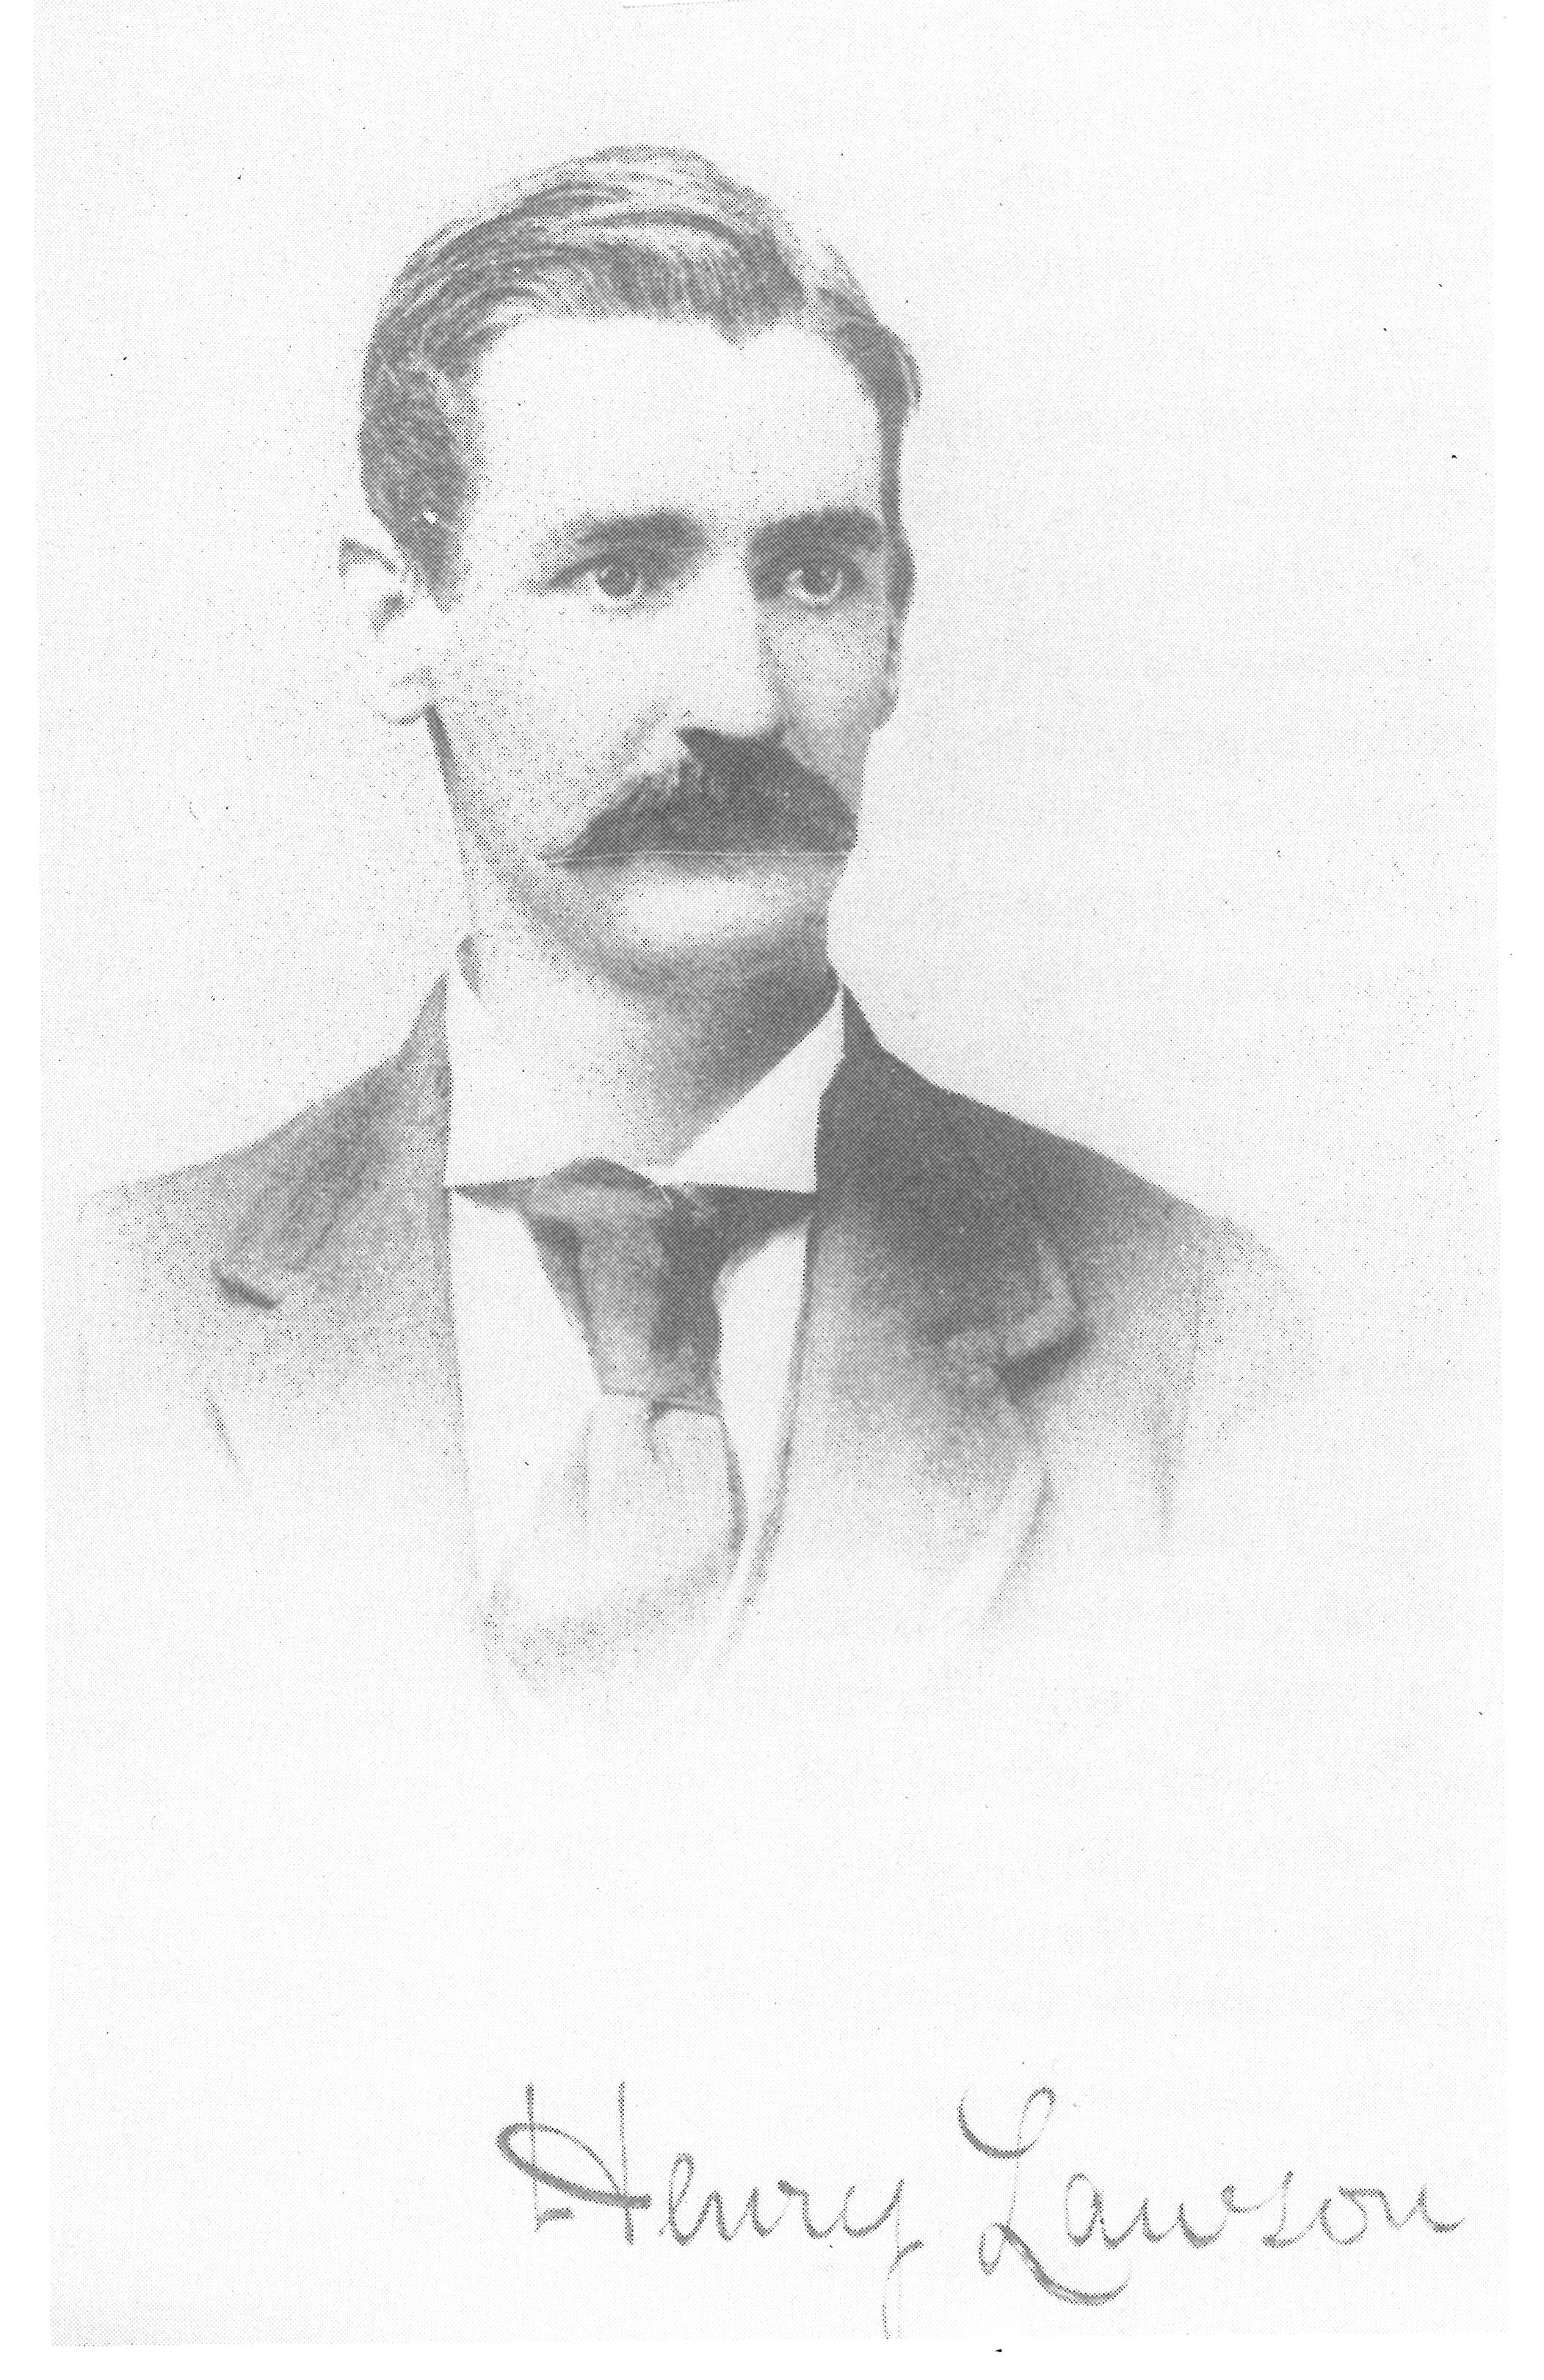
Henry Lawson 1900

Slide 21
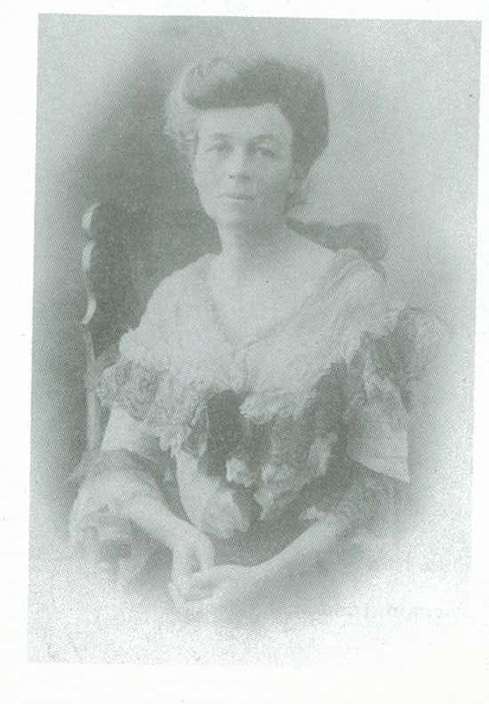
Barbara Baynton c.1903

Slide 22
Barbara Baynton: 'Squeaker's Mate' and 'The Chosen Vessel’
Baynton's two stories represent very different positions from Lawson's. In 'Squeaker's Mate' and 'The Chosen Vessel' from her collection of stories Bush Studies (1902) men are represented as
lazy
stupid
selfish
cruel
treacherous
evil
superstitious
cowardly

Slide 23
‘Squeaker’s Mate’
In the opening page, Baynton undercuts and overturns a number of gender stereotypes:
femininity
division of labour
intelligence
strength of will
Squeaker's mate not only confounds the men, she also upsets the women and can be seen as someone whose gender fits into neither male nor female categories. The violent stand-off between the two women at the end of the story is the product of a cross gender character trying to inhabit the place of the great Australian myth.
Marilyn Lake sees women's writing of this time as part of a third force in Australian politics, a force that opposes substantial sections of masculinist politics. Writers like Baynton interrogate gender stereotypes and present alternative constructions and deconstructions.

Slide 24
Practical Applications
Be wary when reading: ask yourselves questions about who is speaking, how the sexes are characterised, and if there are any recurring patterns in texts with no apparent connections (eg Coonardoo and Wake in Fright).
Think critically: read Lake’s article, and apply her ideas to notions of nationhood today. Which attitudes have prevailed? Where can you see them?
Read widely: Julienne Van Loon, Elizabeth Jolley, Enza Gandalfo, Liz Byrski, Sophie Cunningham, Sonya Hartnett, Kate Grenville, Helen Garner, Drusilla Modjeska, Cate Kennedy, Gwen Harwood, Judith Wright, Tracy Ryan, Simone Lazaroo and Joan London are just a few Australian female authors whose work you can seek out.

Slide 25
Source of Illustrations
Miss New Woman, Bulletin, 15 February 1896 from Marion Fletcher Costume in Australia 1788-1901, Oxford University Press, Melbourne, 1984, p.172
Henry Lawson title page from his In the Days When the World Was Wide 1900 in Colin Roderick The Real Henry Lawson, Rigby, Melbourne, 1982, p. 66
Barbara Baynton from Penne Hackforth-Jones Barbara Baynton: Between Two Worlds, Melbourne University Press, 1995, n. pag.

