Slide 1
ACP2070 Editing Principles and Practice 2014
Lecture 6
Style

Slide 2
A Style Guide:
rules or conventions set out by a publishing house, journal or press
outline the correct approach to take to questions of ‘style’ which are questions of preference and choice rather than grammatical or linguistic necessity (i.e. where there is not a straightforward ‘right' or ‘wrong' decision).
also called ‘house style', the company's or press's style.

Slide 3
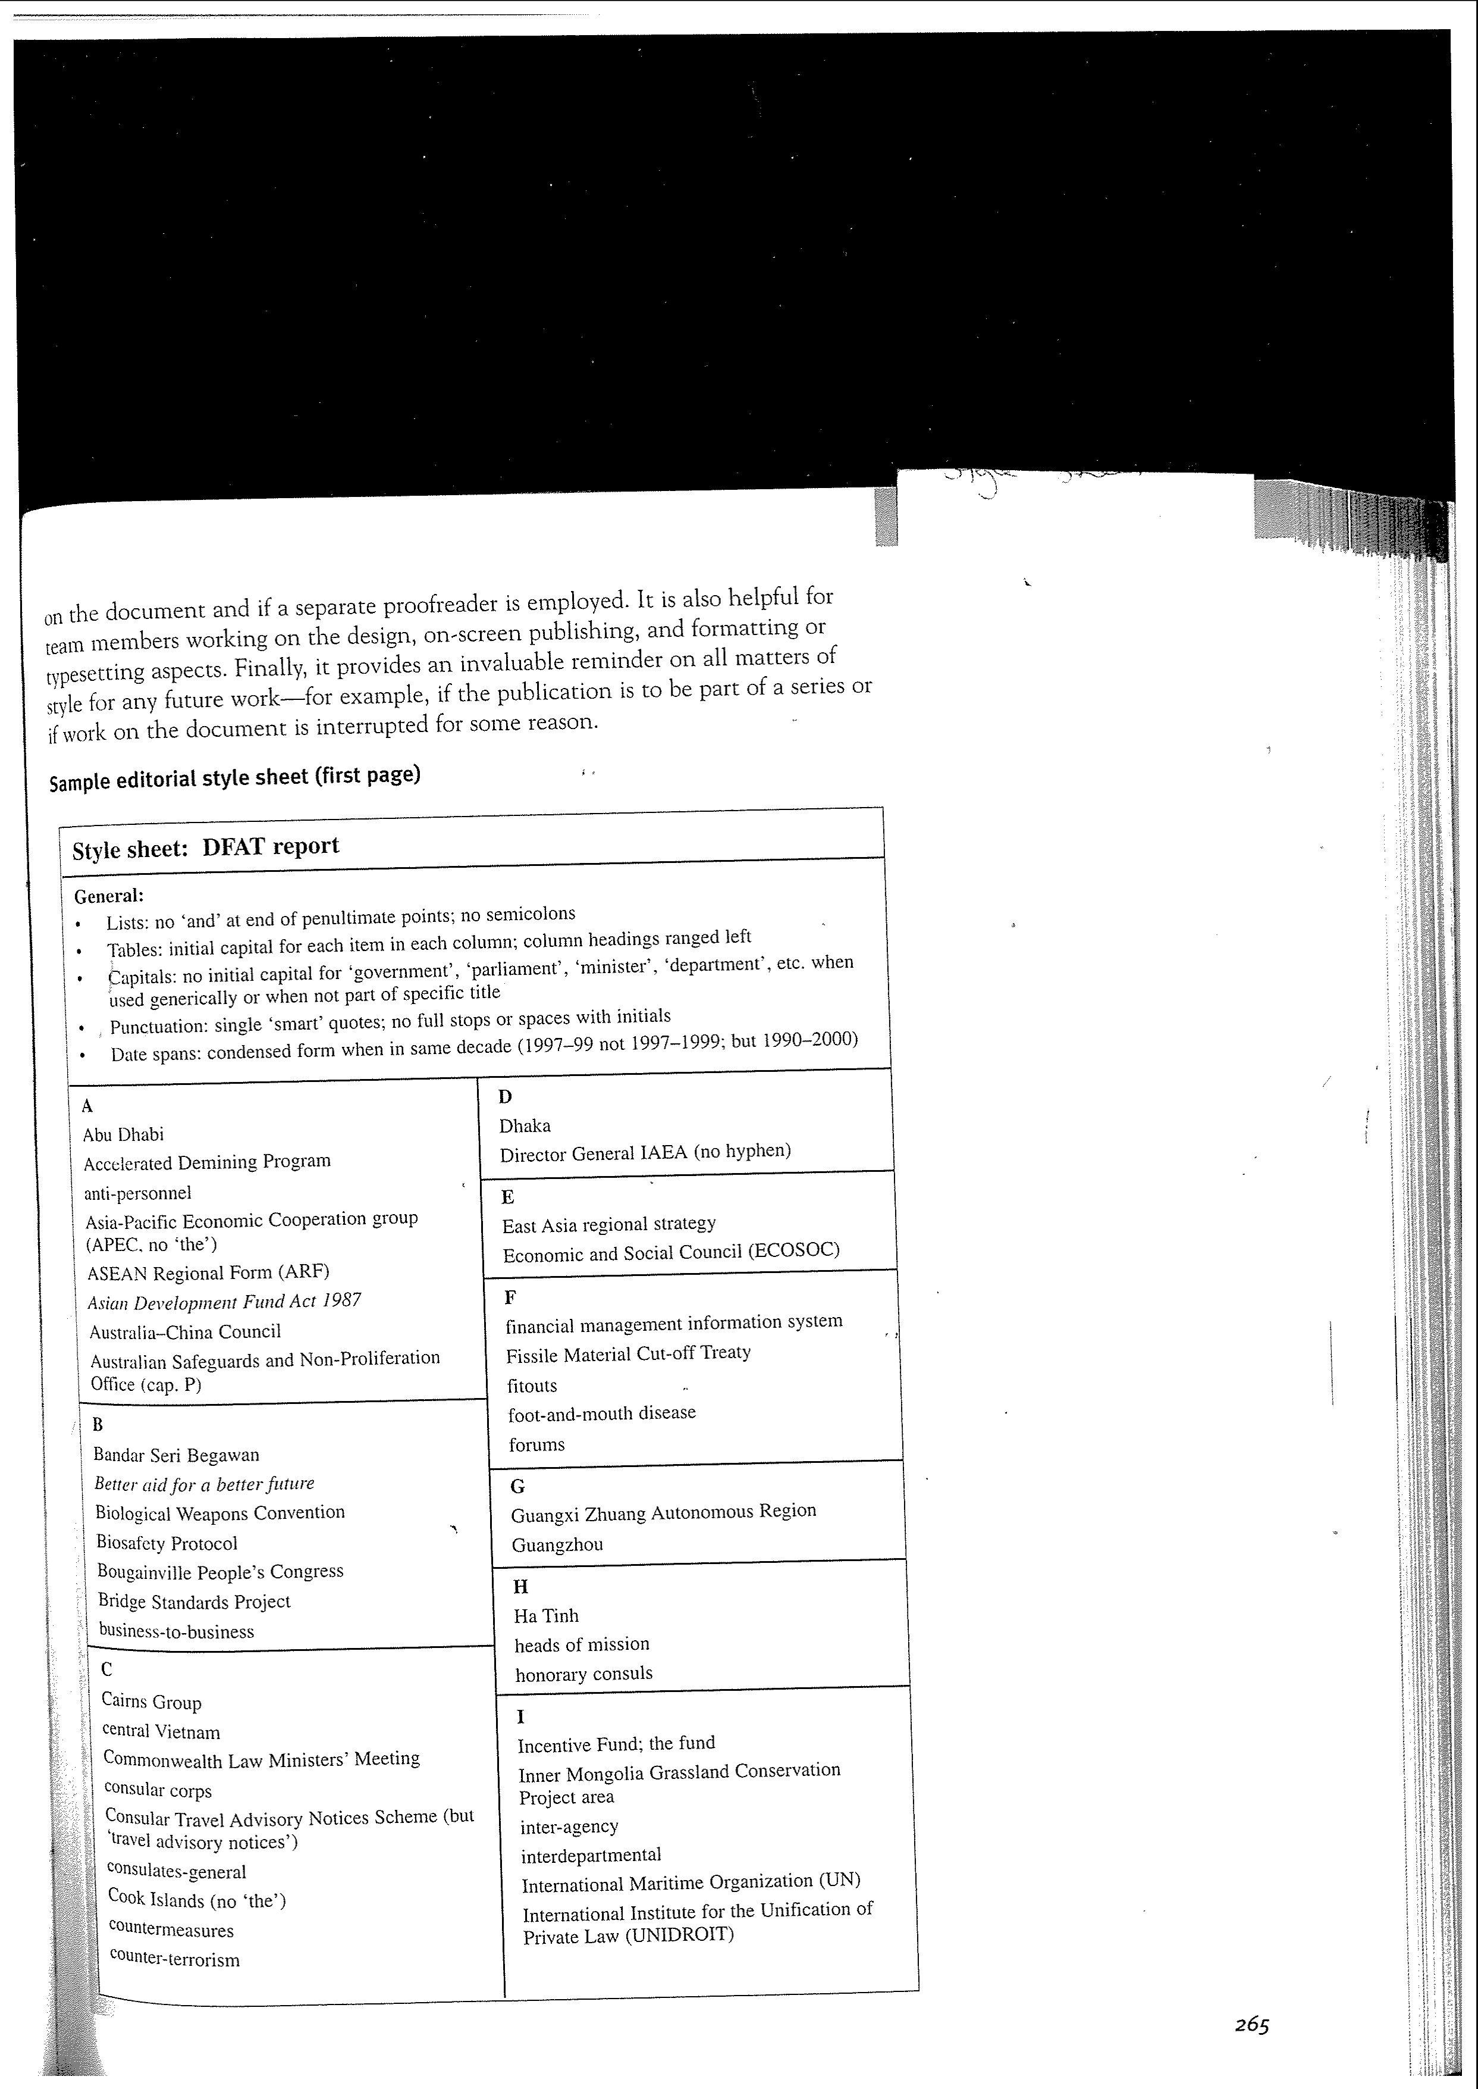

Slide 4
Things covered by the term ‘style guide' include:
‘House style'
Author's style guide
Style sheet
The particular Australian Style Manual you are using in this course.

Slide 5
What sorts of things might a style sheet cover?
Foreign words and accents eg. Café
Single or double quotation marks
Footnote and endnote style
Maximal or minimal capitalisation
Australian or American spelling
Preferred choice in alternative spellings - inquiry or enquiry? Ageing or aging?
Coined terms and slang, swear words.
Dates (24 July 2008 or July 24, 2008?)

Slide 6
Hyphenation - co-operation or ad-hoc
Abbreviations
Structure and consistency for items in a list
unusual or invented terms such as ‘droog' or ‘muggle' - as is, within quote marks, or in italics.
numbers or sets of statistics - appear as words (ten) or numerals (10) and whether these rules change depending on the frequency or size of the numbers
Typographical decisions - whether ellipses…will be spaced and what sort of dash to use.

Slide 7
Mum's a nagger even if she loves me. She reckons Shelley's a bogan who only cares about catching the perfect pipe. But Shelley's ace and I'm thinking whatever.com
Mum's a “nagger” even if she loves me. She reckons Shelley's a “bogan” who only cares about catching the “perfect pipe”. But Shelley's ace and I'm thinking “whatever.com”

Slide 8
Particular style questions or language usage?
An academic journal
A street music press
A government publication
A young adult novel
A French cookery book?

Slide 9
While English has this richness and capacity for subtlety it also contains the bases for innumerable disagreements about usage.
Various substantial etymological roots - Latin, Norman French, Old English. See p 76 MacKenzie)
A variety of places and cultures where English has followed its own path. The rise of Chinglish.
Two hundred years of cultural and linguistic exchange between the outposts of the English empire which has further confused the matter.

Slide 10
The validity of our historical and etymological justifications
Consistency
Audience
Practical outcome

Slide 11
Abbreviations, Acronyms & Initialisms (see Style Manual p150-62)
Qld
Tas.
WA/Western Australia
VU/Victoria University
QANTAS
1. audience familiarity
2. aesthetic considerations

Slide 12
Capital Letters (the Style Manual has some rules on government titles, p. 124)
Proper names – and when do capitals disappear from proper names?
Official titles
Geographical names
Unique historical events
Scientific terms
Commercial names/trademarked brands (Venetian blinds, HarperCollins)

Slide 13
Apostrophes
In Australian English we never use an apostrophe to signal the plural:
- 2000's

Slide 14
Possessive
The teacher's lectures
The teachers' lectures
What do we do when a singular possessive noun ends with an s?

Slide 15
The usual rule is to add ‘s’ but some surnames ending in ‘s’ may occasionally be an exception to this depending on the sound. The below examples concern names ending in ‘s’.
s-sound: Mr Lewis's opinion
z-sound: Davy Jones' Locker
Singular possessive nouns that end in ‘s’ and that are not names will always require an apostrophe and an ‘s’ (the boss’s car).
Plural possessive nouns ending in ‘s’ only require an apostrophe (the bosses’ happiness, the workers' revolution).

Slide 16
Contractions
don't
won't
could’ve
should’ve

Slide 17
Italics
Emphasis
Foreign words – acclimatisation
Not naturalised - Je ne sais quoi
Naturalised - status quo, de facto
Do we use them for books and magazines?
Newspapers? the Age , or The Age ?
the Australian, The Times?

Slide 18
Numbers
When do we spell them out/ use numerals?
Depends on the kind of publication. In texts where very few numbers are used it is just as well to spell them out.
Threshold becomes important when a text uses many words. Difficulty when numbers in one sentence are above and below the threshold.
Never start a sentence with a figure – rewrite.
What about:
“1984 is the most important book of the twentieth century.”

Slide 19
Style sheet
Is put together on a job-by-job basis. It is meant to cover anything that is subject to variation from house style or is not covered by house style.
It is also meant to ensure consistency in an author's usage.

Slide 20
Even in the course of today's lecture I've had to make many tiny decisions of style:
Do I make textbook one word or two or hyphenated?
Do I italicise ‘the' in the name of the Style Manual ?
Am I using smart or straight quotes?
Do I want my lists to be full sentences or not?

Slide 21
