Slide 1
ACL 2009 Australian Literature
‘A Fair Go’: Mateship and Bullying in Australian Literature

Slide 2
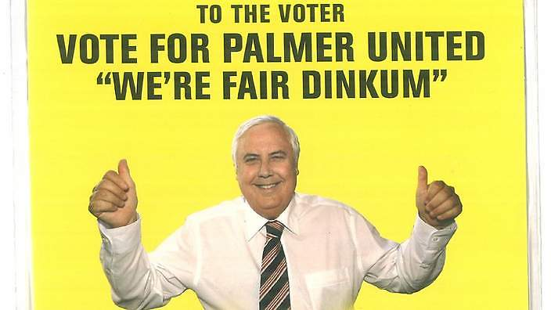
Recently politicians have attempted to use Australian idiom to ingratiate themselves to the electorate.
In some quarters there was distress when Prime Minister Rudd used the expression ‘fair shake of the sauce bottle’ in June 2009. Some accused him of not being ‘the full bottle' on Australian idioms. The underlying idiom is the old and well-established ‘fair go’, which was first recorded in Australian English in 1904. As an interjection, this means ‘steady on!; be reasonable!; give us a go!’. Over the years many variants have appeared. It seems that those criticizing Rudd could be accused of preferring an Americanism to Rudd's formulation. In this instance he wasn't as far off the mark as some would have it. In the end what Rudd said was legitimate. Less legitimate was his attempt to connect with voters through an inauthentic adoption of ‘ordinary language'.

Slide 3
John Howard was another politician who connected strategically to the ‘Australian people'. His much-vaunted love of cricket is an example. Howard also was aware of the need to capture the vernacular for his politics.
In March 1999 Prime Minister John Howard released a draft of a proposed preamble to the Constitution. The preamble was written by poet Les Murray in consultation with Howard. Les Murray's Preamble
Murray was not supportive of the inclusion of the word “mateship” considering it too ‘blokey’. Howard reluctantly dropped the term from the preamble after the Australian Democrats refused to allow it to be passed by the Senate. Ultimately the proposed preamble failed.
Les Murray
Photo: James Croucher, NewsPix

Slide 4
Ref: Scalmer, S 1999 'The Battlers versus the Elites: The Australian Right’s Language of Class’, Overland 154, pp. 9-13 and Scalmer, S 2008 'A postscript, A Prospect‘ Overland 191, pp. 27-33.
Historian Sean Scalmer has demonstrated the way in which John Howard appropriated terms previously associated with the Left in order to connect with a certain section of the working class. Words and terms like
Battler
Mateship
Fair go
were turned into words that could apply to people who were well off but who saw themselves as being exploited by an inner-city left-wing elite.
People who were ‘natural' Labor voters (self-employed tradesmen, people working in the mining industry) were seduced by the rhetoric of their exploitation by greenies, do-gooders, queue-jumping asylum seekers and so forth.
It seemed in the early part of this century that 4wd-driving, Foxtel-watching, 100k per annum battlers and their mates only wanted a fair go.
Terms that once applied to people who were unemployed, living below the poverty line or disadvantaged in other ways were turned upside down to reconstruct these people as the oppressors of Howard's Battlers.

Slide 5
Howard on who are the battlers
No doubt this is all a little confusing. Who is right; just who are the battlers then?
The reasons politicians are so keen to capture the demotic is that Australia has a rich rhetorical history of egalitarianism and fair play. Whether Australia has a rich actual history of these characteristics is another matter.
Whoever sets the framework of this rhetoric wields a lot of power
We hear many stories of fair play that have come down to us:
convict solidarity
bush mateship
Ned Kelly
bush unionism
ANZAC
sporting fairness
But each of them if taken too uncritically can mask stories of bullying, cruelty and treachery that sit alongside these more noble narratives

Slide 6
This week's stories have been chosen because they engage with this question of the way Australians treat each other.
They ask:
How do those in power treat those below them?
How do insiders treat outsiders?
How do those who mistreat others see their actions?
How do people treat their peers?
Just what is Australian egalitarianism?

Slide 7
Peter Carey, 'Crabs' (1972) – a surreal story about being trapped in a drive-in cinema – about what happens when refugees are gathered and the dynamics of power in such situations – about the absence of egalitarianism in high pressure situations – about the limits to anarchy.
The central character Crabs, a victim of bullying, borrows his friend Frank's car to go to the Drive-In with his girlfriend. It's a risky business but Crabs thinks it is worth the risk because of the potential benefits he will get out of it.
Unfortunately Frank's car has its wheels stolen and so they are stuck in the Drive-in indefinitely.
The story is an allegory: but an allegory of what? There are ways in which it prefigures the detention camps of the last decade in Australia. The castaways jealously guard their prison and regard the migrants with hostility and fear (pp. 239, 244).
Perhaps it is also talking about a future in which our obsession with cars is complete (p. 241).
Crabs abandons his girlfriend and morphs into a phallic vehicle because he is totally at one with the idea that cars are at the centre of life. A changing Australia prompts Crabs to change into a "a motor car or vehicle in good health" (pp. 244-245).

Slide 8
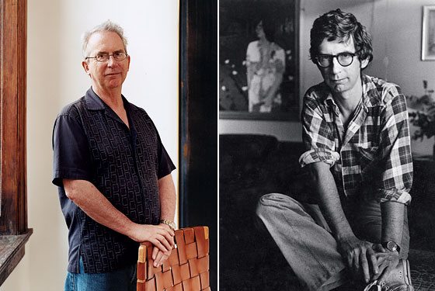
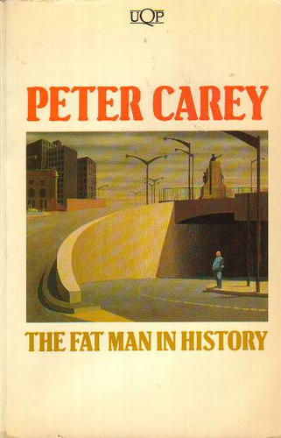
Peter Carey in New York in 2007 and in Australia in 1976
Photos: From left, Stuart O’Sullivan/Orchard by Getty Images for New York Magazine; courtesy of Peter Carey
Carey’s first book, a short-story collection,
published in 1974

Slide 9
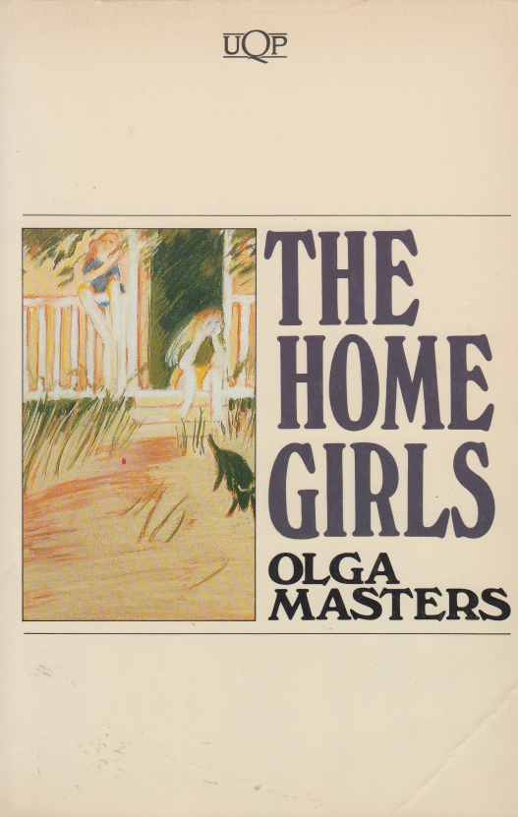
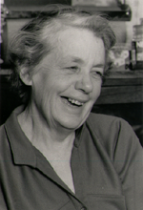
Olga Masters, 'The Rages of Mrs Torrens' (1982) – small town rejection of eccentricity and madness. Yet it reveals a hypocrisy beneath the rejection. The failure of the town to discuss the final rage of Mrs Torrens is because it was too close to some truths that were not to be spoken (p. 306).
Olga Masters had a short but brilliant career as a fiction writer in her sixties after decades of journalism and raising a family. She uses the realist tradition to explore female experience and the lives of ‘ordinary’ people.
Masters’ first collection of stories,
published in 1982
Olga Masters
Source: The Age

Slide 10
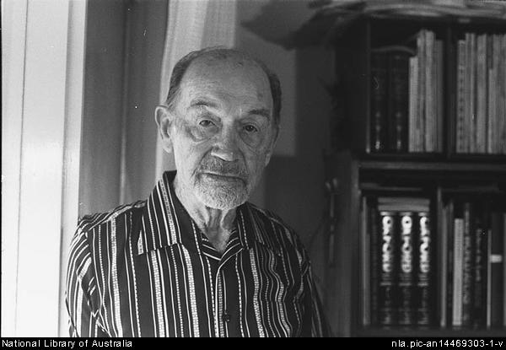
John Morrison 'North Wind' (1947) – the story of a man who tries his best to do the right thing in a perilous situation. What happens when we read behind the main character's rhetoric? Is he in fact someone who has manipulated a situation and the telling of the story to put himself in a better light? An intense preoccupation with the morality of conduct has been a hallmark of Australian realism from Henry Lawson and Joseph Furphy on (Indyk 1987, p. 507).
Morrison also wrote a fabulously mean story about a syndicate that won lotto and the person holding the ticket kept the winnings for himself.
Morrison belonged to the social realist circle of writers identified with the Communist Party of Australia.
John Morrison 1986 by A.T. Bolton

Slide 11
Photograph by Sean Blocksidge
In ‘North Wind’ Morrison placed his story in the midst of a bush fire that broke out in Beaumaris. A Gothic landscape becomes charged with the main character’s emotions. As with other social realists, traditional Romantic elements are frequent in Morrison’s work.
The fire becomes a metaphor of a hostility between the narrator and his mother-in-law that threatens to destroy his marriage.
The fire elicits a spirit of co-operation between the men who fight it, many of them neighbours.
Fire, a quintessentially Australian disaster, finds expression in the visual arts, poetry and children’s literature but novels and short stories in which bushfire is central to the narrative are surprisingly rare (Schauble 2008).

Slide 12
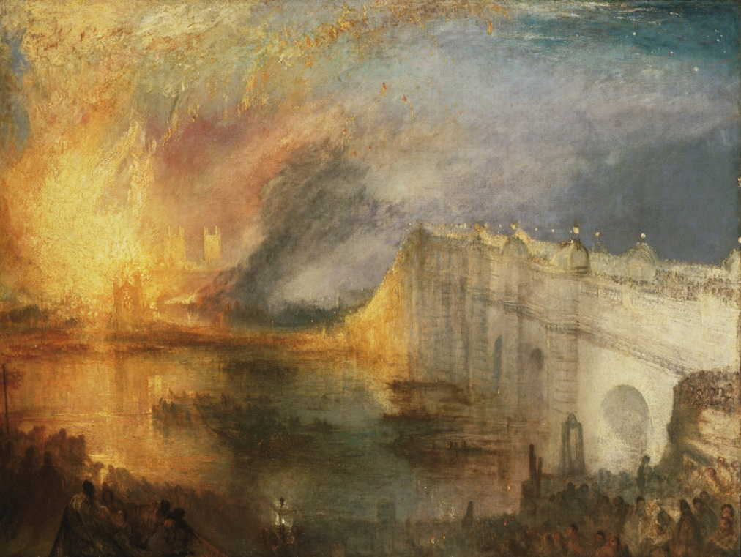
Les Murray’s oeuvre might be read as a celebration of small town mindedness as opposed to the brutality of the city. This was revealed in 'Sydney and the Bush' (1976).
Read ‘The Quality of Sprawl‘ (1983)
To Murray sprawl is an Australian attitude
The poem is laconic and easy going
In line 29 is Murray celebrating the destruction of government? The last line of the poem, however, seems to valorize suppression by brute force.
J.W. Turner Burning of the Houses of Parliament 1834 (1835) Philadelphia Museum of Art

Slide 13
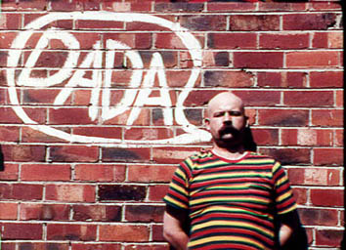
Jas H. Duke sees Australian history as a narrative of bullying.
Eureka poems and 'Happy Birthday Australia‘
“Written in a direct, unadorned style”, Duke’s poems “engage with the underdog and demonstrate a deep dissatisfaction with the inequalities within society” (Attfield 2005, p. 180).
Duke’s poems also typically display deadpan humour.
A cult figure in the Australian performance poetry scene, Duke was influenced by European avant-garde art movements such as Dada.
Jas H. Duke 1939-1992

Slide 14
Should this unit be called Un-Australian literature?
Throughout this unit we have explored:
the Cultural Cringe
the rise and fall of Australian literature
hell
the binaries of city and the bush
deconstruction of the received Australian legend
gender
Aboriginality
Many of the texts discussed are rather depressing. This is not necessarily a reflection of Ian Syson’s taste.
We have studied classics including the work of A.B. Paterson, Henry Lawson, Katharine Prichard and Les Murray.
What is Australian literature? I do not expect you to know but I hope this unit has given you a sense of the diversity and richness of the literature of Australia.
Image: Reading Australia
Lani Giesen Creative Commons

