Slide 1
ACL 2009 Australian Literature
Aboriginal Voices

Slide 2
Given the overwhelmingly oral nature of Aboriginal story-telling prior to the mid 1960s, the relatively recent emergence of a written/literary Aboriginal culture is of immense value
a particular kind of mediation of the Land Rights struggle
a particular kind of mediation of Aboriginal politics in general
a chance for non-Aboriginal people to hear stories told by Aborigines
a written inflection of a rich cultural tradition
an artistic critique of what academic Cliff Watego calls whiteaustralia
In the early 1990s in a lecture at the University of Queensland Cliff Watego described whiteaustralia in this way:
The term refers to the ideal image of Australia which had been implanted on our (blackfella) country by the invading British, encouraged by both the British and the emerging squattocracy ("landed gentry"), and firmly entrenched by the Commonwealth constitution in 1901. This construction of an ideal Australia thus militated and continues to militate against Black Australians achieving justice and therefore parity with the ruling sector...
Black Australia responds to this by writing about the conditions Blacks are forced into, such as the history of mistakes regarding Aboriginal policy throughout British invasion and consequent governments. The Black text explores ironies played out by a conflict of values and standards foisted upon an OPPRESSED INDIGENOUS SOVEREIGN people by an indecisive oppressor. Historically the dilemma manifests itself in the white sector's wish to be rid of the "Aboriginal problem," and on the other hand wanting to accept Blacks in terms of universal brotherhood. (Lecture Notes)

Slide 3
Yet, Aboriginal people were not the only ones to be subjugated through British imperialism. The invasion of Aboriginal land is a moment of at least two clear examples of British imperial barbarity. For Hodge and Mishra:
Australia was founded on a double guilt: the dispossession of the Aboriginal people and the excessive punishment of large numbers of British and Irish people, mainly from the poorer classes, for crimes against the property of the ruling class (1991, p.116).
With this in mind it is worth drawing a formal link between the oral nature of Aboriginal culture and one of the imported cultures at the time of invasion.
Gillen makes the point in "Mightier than the Sword?" (1988) that
an oral culture also arrived on the First Fleet. Illiterate or semi-literate convicts brought with them a tradition of folk songs and street ballads, jokes and anecdotes. Their songs developed into the bush ballads of the nineteenth century, which were eventually sanitized and admitted to the mainstream of Australian literature. The oral tradition survived into the twentieth century with the popular urban songs of the depression and the protest songs of the 1960s. (190)
Now we know enough about the history of working class literature to know that a great deal of written material came out of what was a largely oral culture.
This forces us to accept the possibility that there is a great deal of valuable material written by Aboriginal people all the way back to the early years of Australia’s colonization. Recent discoveries of work by Indigenous authors, such as Bennelong’s 1796 letter to his patron, support this view (Wheeler 2013, p. 3).

Slide 4
Consequences of the argument so far:
Aboriginal writing takes on some of the characteristics of story-telling; Stephen Muecke's notion of oral literature
Aboriginal writing is conscious of its own very short history as a writing but also conscious of a very deep and broad history of Aboriginality
Aboriginal writing can sometimes seem to be aggressive or angry in the way it relates the prior exclusion from literacy
Aboriginal writing is aware of the pitfalls and the benefits of being a newly emergent literary form
Form
It is around this question of form that important issues to do with Aboriginal writing emerge.
Given the problems of previous attempts to represent Aboriginality (eg Coonardoo but plenty of others) is the problem not so much one of racist intention but of racist structure?
No matter how anti-racist Katharine Susannah Prichard might have been, no matter how anti-racist her intention, is there something about the ideological and generic structures that she operates within that prevents her success. Is her only practical goal to dismantle the prejudice of her own vehicles of expression?

Slide 5
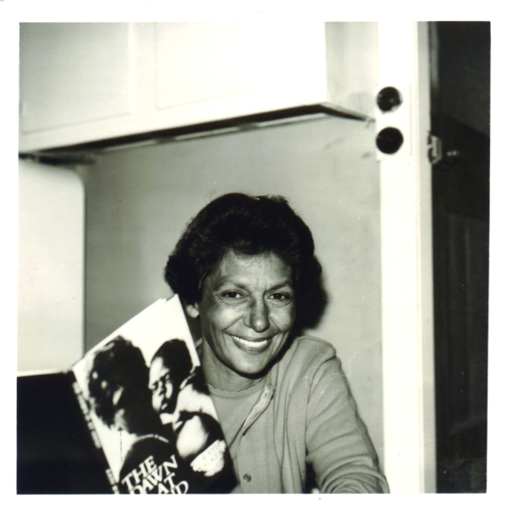
We all operate within ideological frameworks that structure our world view.
For example?
Generic structures pre-determine particular possibilities in which a racist outcome is ‘necessary'.
For example?
The solution to the misrepresentation of Aboriginal people was not to fill standard narratives with Aboriginal characters but to find new modes in which to represent Aboriginality.
Read 'Artist Son’ (1966 ) by author and activist Oodgeroo (meaning ‘paperbark tree’) of the Noonuccal tribe, formerly Kath Walker, (born 1920 Stradbroke Island and died 1993)
See Unit Reader
Kath Walker holding her second volume of poetry
The Dawn Is at Hand (1966)
Collection: Uni of Qld Library

Slide 6
It is possible to read this poem as an expression of artistic individualism. However, it could also be read allegorically or metonymically: the artist son stands for the whole of the Aboriginal art and literature movement which was then emerging into the white world.
“striving alone to find What colour and form can say”
striving to find a form to give voice to Aboriginal aspirations
“Your fathers too fashioned their art Who had but bark and wood and the cave stone”
there is a heritage or tradition of art and song to follow which used a different technology
“But copy none; follow no fashions”
Aboriginal art is in a position to create a whole new artistic mindset and so should not be swayed by other forms
“Make us songs in colour and line: Painting is speech, painter and poet are one”
The poem unifies different artistic forms as being vehicles for the same purpose; speech and poetry are considered equivalent or identical.
When interpreted in this way the poem becomes a manifesto for Aboriginal writers and artists.

Slide 7
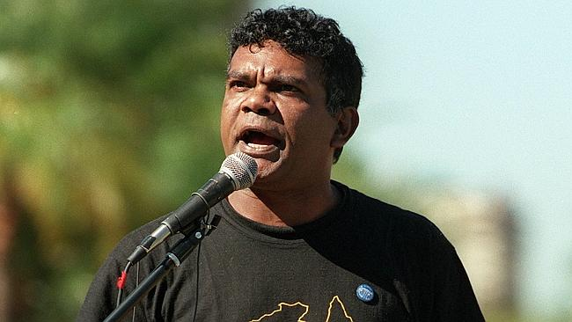
(It is interesting that Aboriginal writing is often accompanied by images. Both today's poets have images illustrating their poetry. It is worth discussing this.)
‘Artist Son' also offers itself as a theoretical precursor to Stephen Muecke's idea of oral literature in which the oral and the literate are intimately entwined. He acknowledges the apparent contradiction and makes the point that "it is through the printed word that most white Australians come to know about Aboriginal oral texts." See “Aboriginal Literature” (1988) Penguin New Literary History of Australia p. 27.
While the oral and the literate are analytically separate categories, practically the two are inseparable.
Lionel Fogarty (b. 1958 at Barambah Mission, now known as Cherbourg Aboriginal Reserve, Queensland) is another poet whose work relates to this.
Lionel Fogarty
Photo: News Corp Australia

Slide 8
Fogarty has lived in Brisbane since he was sixteen. Since the 1970s he has been a leading spokesperson for Indigenous rights and has travelled widely as an ambassador for his Murri culture . His poetry is often angry and confrontational. It spews back the English language to resist its colonizing force.
His poem 'Tired of Writing' (1982) deals with similar issues to Oodgeroo's poem -- yet departs in interesting ways (Unit Reader). Fogarty expresses the difficulty of writing as an indigenous poet in contemporary Australia.
The final six or so lines are worth focusing on. Fogarty is disingenuous. His use of the English language here is perfect.
Anger also is an interesting departure in Fogarty. Oodgeroo's poems are characterised by little anger, what anger is there is tightly restrained. Fogarty is quite happy to be angry and adversarial. It is part of his method.
Both ‘Artist Son’ and ‘Tired of Writing’ recall ‘In My Craft or Sullen Art’ (1946) by influential Welsh poet Dylan Thomas.
When we look at an older generation of Aboriginal writers, anger is never far from the surface -- though nor is it an overwhelming force -- much humour is on display as well.

Slide 9
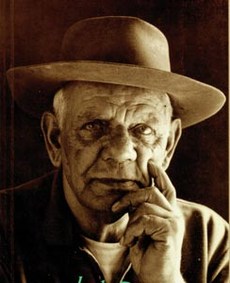
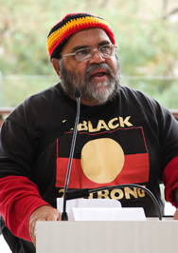
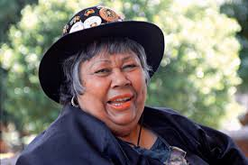
Jack Davis (1917-2000) grew up at Yarloop, Western Australia and was active as an Aboriginal spokesperson since the 1960s. His many plays and poems draw on his own experiences and those of his family and the Noongar people. Compared to Oodgeroo and Fogarty there is a more traditional sense of ‘yarning' to his writing but he still mediates anger.
Ruby Langford Ginibi (1934-2011) was born Coraki, New South Wales, at Box Ridge Mission and lived in various parts of NSW and in Queensland. She tells the story of her hard life and the stories of her people. Her writing is humorous, poignant and strikingly frank.
Sam Watson (born 1952) is a Brisbane writer, activist and lecturer. His novel The Kadaitcha Sung (1990) mixes urban realism and magic realism -- Mudrooroo sees this as a particularly valuable form of writing. Yet magic realism is observable only to modern Western minds in which the ordinary and the extraordinary, history and myth, are situated as binary opposites (van Toorn “Indigenous texts and narratives”, 2000, p.39).
Ruby Langford
Jack Davis
Sam Watson

Slide 10
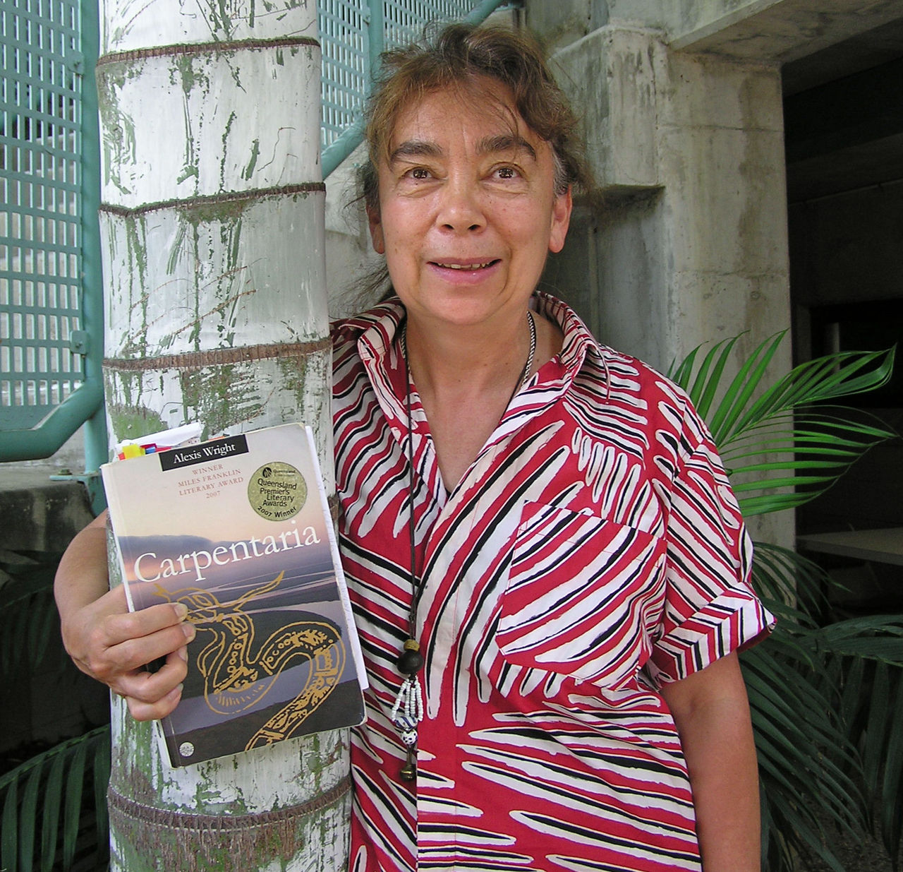
Born in Cloncurry, Queensland in 1950, Alexis Wright is of the Waanyi people from the highlands of the southern Gulf of Carpentaria. A writer and activist, she now lives in Melbourne.
In Carpentaria (2006) she has written one of the most ambitious novels in Australian literary history (Excerpt in Unit Reader). It is a novel that has generated much positive critical comment and many literary awards.
Alexis Wright
Photo CQ Uni

Slide 11
Ian Syson’s review of Carpentaria from Overland no. 187, 2007 pp. 85-86
Phew! I'm glad I finished Carpentaria : a remarkable and huge dreamscape novel that begs and mostly deserves all the high praise and literary prizes thrown its way. The range and diversity of form, content and influences crammed into its bulky frame is astounding. Nonetheless, I am left uncertain as to what to think of Carpentaria. Is it a rambling showing-off of Wright's undoubted literary skills? Is it a mere pastiche of good ideas? Is it a book that, despite what can be taken for flaws and impasses, ends up a pleasing and important document of our time? I just don't know. The fact that when read­ing I kept drawing comparisons with Patrick White's Tree of Man – especially in relation to the sense of satisfaction in having finished what felt like an Australian epic – leads me to believe the latter . . . perhaps.
Set in Desperance, an imaginary town inland from the southern shore of the Gulf of Carpentaria, the novel tells the story of a community of Aborigi­nal and white characters, many of whom are drawn larger and deeper than life and reason. They include preserver of fish, Normal Phantom (whose name suggests that Desperance is based upon the Gulf town of Normanton), and his estranged son Will (a character seemingly based on Murrandoo Yanner), Norm's wife Angel Day, Mozzie Fishman, Mayor Bruiser, the town cop Truthful E'Strange and a number of others. In the very naming of places and characters some will rightfully hear echoes of Dickens' grotesqueries; others will detect the culturally closer influences of Xavier Herbert and Frank Hardy. And there is something distinctly Joycean about the lilting rhythm of the section focused on the bohemian Catholic priest – even while Beckett supplies the causal logic.
In the book's method some will observe the presence of magic realism and see Carpentaria as a major Australian landmark in that genre. Writers like Peter Carey and Richard Flanagan (who wrote the other book of fish) made the early going but Wright might well have perfected the art for Australia – giving the magic more indigenous and Indigenous sources. The novel has a plot; one is there lurking, unfolding its intricacies, but at a secondary level. Wright seems more concerned with the pyrotechnics that explode out of her storyline; more concerned to weave dreamscapes out of conflict and love and desire than to generate a plot.

Slide 12
There is nonetheless a strong plot: generations-old small-town racism; police brutality towards Aboriginal people; the impact all this has on one Aboriginal family that splits into spiritual/activist factions; the nearby mining settlement that has a disturbing and corrupting economic and spiritual influence on the whole region; a climax during which Aboriginal activists destroy the mine in a violent act of political vengeance; and an ending which gestures towards social and familial forgiveness and reconciliation. Indeed, these are the bones of a contemporary realist political novel – like Steven Lang's Ac­cidental Terrorist – but they are bones that do not get fleshed out. Wright has other, more magical, skeletons to present.
It seems clear that Wright is not interested in writing a realist novel. The narrative is sometimes blatantly anti-realist, as in the following sarcastic comment: “Desperance being what it was, a modest place, humble people believed in real facts. Only real facts created perfection. So it was. People were not fools.” Yet there are points in this book where, tellingly, Wright drops all ornament and tells it straight. In a four-page section dealing with the bashing of three Aboriginal boys in a police cell, Wright's rage is almost palpable through the absence of symbol and dream and metaphor. The bashing complete, the book returns to its more ornamental, magic-enabling mode.
While Wright will write in whatever mode she chooses, does she have a sense of audience? Who will read Carpentaria ? Does she expect it to sell well in Cloncurry, her home town? I don't think so, because it is frankly just too difficult to be read by non-professional or non-literary readers.
I mostly enjoyed reading Carpentaria but have to admit to sometimes soldiering on for ‘professional' reasons. Another of the things that kept me soldiering was my recognition of the truths at this book's heart. It is set in a real part of the world and deals with very real contemporary political issues. Having grown up in the region, I felt connected to the geographical and political truth that Wright articulates. I felt the power of the submerged layer of realism that will not be available to the many who don't read this extraordinary book.

Slide 13
On Writing Carpentaria http://www.theaustralian.news.com.au/story/0,20867,21853571-5001986,00.html
The book needed the right voice and rhythm. I wanted the reader to believe in the energy of the Gulf country, to stay with the story as a welcomed stranger, as if the land was telling a story about itself as much as the narrator is telling stories to the land.
From the start, I knew Carpentaria would not be a book suited to a tourist reader, someone easily satisfied by a cheap day out. I wrote most of the novel while listening to music -- I have an eclectic taste that roams around the world collecting a mixture of traditional, classical, new world, blues and country. One of my intentions was to write the novel as though it was a very long melody made of different forms of music, mixed somehow with the voices of the Gulf. The image that explains this style is that of watching an orchestra while listening to the music. Within the whole spectacle of the performance fleeting moments occur, in which your attention will focus on the sudden rise in the massiveness of the strings, horns, or percussion.
This is what happens with this story as it moves through all of the diversity in the mind-world of the water people who are its main characters, descendants of Australia 's original inhabitants. At this level the novel is about the movements of human endeavour, water, weather, fish and plants, while all around the orchestra is surrounded and attacked by wild stories that have been provoked by its symphonies, which is the sound of the music made by the very thought of placing you in their domain.

Slide 14
There is something of what Melissa Lucashenko calls 'earthspeaking' in all of this. The idea that we need to be telling and reading and hearing stories that allow the earth or the land to speak for both spiritual and immediately practical reasons.
Carpentaria, then, represents the great connection between form and content for which Aboriginal writing has been striving and indeed is its great gift to Australian literature.
Aboriginal authors have created some of the best, most distinctive and most significant writing to come from Australia (Jose in Heiss & Minter eds. 2008, p. xiv). Aboriginal literature has become an integral component of Australian literature and many communities from around the world are increasingly noticing the work of Australian Aboriginal writers (Wheeler 2013, p. 13). Tony Birch, Ellen van Neerven-Currie, Tara June Winch, Melissa Lucashenko, Kim Scott, John Muk Muk Burke, Alexis Wright, Marie Munkara, Larissa Behrendt, Anita Heiss, Bruce Pascoe, Philip McLaren, Doris Pilkington, Gayle Kennedy, Sally Morgan, Ali Cobby Eckermann, Lionel Fogarty and many others have “contributed to the excitement around Indigenous literature that exists in Australia today” (Chris Flynn, “Introduction to Terra Australis”, McSweeney’s 41, 2012, p. 194) .

