Slide 1
ACL 2009 Australian Literature
The Construction of Aboriginality

Slide 2
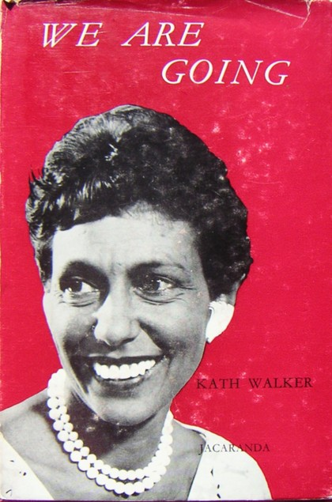
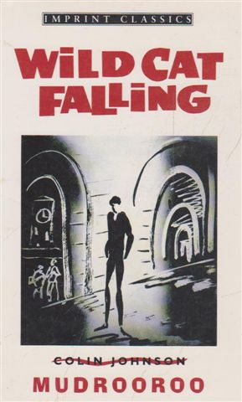
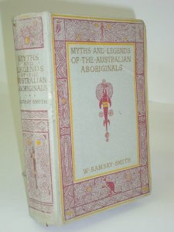
Prior to the publication of the first book of poetry by an Aborigine, Oodgeroo Noonuccal's
We Are Going (1964) and the first Aboriginal novel, Mudrooroo's Wild Cat Falling (1965), there had been only fragmentary and occasional publication of writing by Aboriginal people. Examples include writing published in the left-wing journal Realist Writer in 1961 and women's magazines in the 1930s.
Qualification: that we know of!
For example, David Unaipon's work had been published in 1930 as Myths and Legends of the Australian Aboriginals, but under the name of a white anthropologist, William Ramsay Smith. This is only the first in a line of frauds in relation to aboriginal writing and art.
To what extent were other published works plagiarized from aboriginal writers?

Slide 3
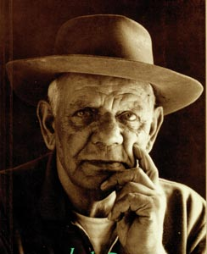
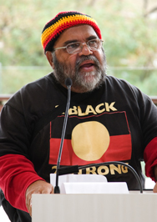
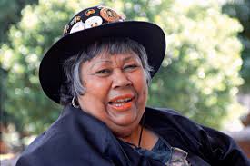
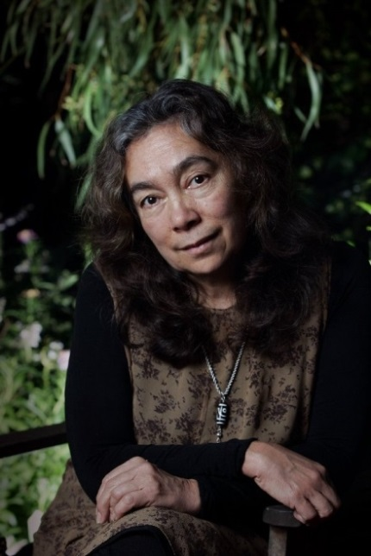
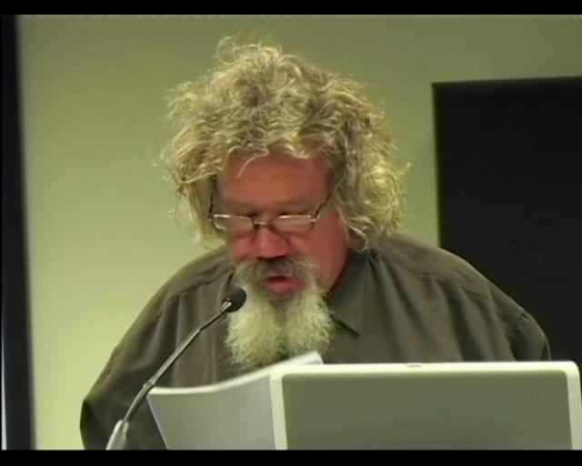
Since the mid 1960s there has been an explosion of published Aboriginal writings. Jack Davis; Sally Morgan; Sam Watson; Ruby Langford; Archie Weller; Alexis Wright and Melissa Lucashenko are just some who have emerged to relative prominence.
Ruby Langford
Sam Watson
Jack Davis
Sally Morgan
Melissa Lucashenko
Alexis Wright
Archie Weller

Slide 4
Nevertheless, prior to the mid 1960s, Aboriginal story-telling was largely an oral and pictorial tradition. The written record (and thereby the dominant received construction of Aboriginality) was very much a European/colonial record.
History
In the colonisation/settling/invasion of Aboriginal land, literacy was a significant aspect of Britain 's imperial project.
Documentation was crucial
Instructions were given to government and agents such as explorers and soldiers
Legal writing was involved in the imposition of British law
Geographic and botanical description was a means of ‘capturing' the continent
Interestingly a number of convicts had been convicted of writing offences
A whole network of new writing practices comes to exist in Australia in a few short years.
In a sense, the economic and political dispossession of Aboriginal people is symbolised by the initial `cultural' clash between the invaders' literacy and the Aborigines' orality.
The following picture is an interesting manifestation of this clash.

Slide 5
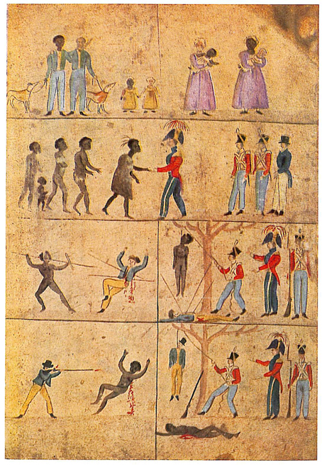
Image devised by Governor Arthur in 1828 to communicate concepts of justice, fairness and equality before the law

Slide 6
The dominance of literate over oral records within the cultural, legal and bureaucratic systems left Aborigines at a huge disadvantage in these areas.
The (at least) 40,000 year development of Aboriginal practices such as story-telling and painting counted for little (if they counted at all) in the minds of British imperialists,
except negatively as examples of Aboriginal 'savagery' and, as a consequence, a justification of the British imperial project (Paul Gillen, ‘Mightier than the Sword?’ Constructing a Culture, 1988, pp. 190-191).
From this moment the Aboriginal oral tradition became, in many of its manifestations, an oppositional cultural form – a form of cultural practice which opposes and tries to undercut more dominant forms.
In ‘Aboriginal Literature’ (1988) in the Penguin New Literary History of Australia, Stephen Muecke points out that:
Aboriginal ‘Oral Literature' is alive and well . . . its response to colonialism was not one of acquiescence, but one of fighting back with words, making stories in order to come to terms with the structure of colonial economy and law and the place Aborigines were supposed to occupy in it; of articulating suffering; of satirising the various figures of the colonial administration and the pastoral industry (p. 28).

Slide 7
This oral culture has, for the last two hundred years, run largely parallel with many, if not all, of the imported cultures;
It is largely separate from and sometimes antagonistic to other Australian cultures.
Until recent years it has been the ‘hidden' component of the history of Australian writing and history. We can see how a book like Alexis Wright’s Carpentaria (2006) functions as a story which reveals a hidden aspect of Australian history.
However, as Bob Hodge and Vijay Mishra warn in Dark Side of the Dream: Australian Literature and the Postcolonial Mind (1990), we cannot see this absence or hidden-ness simply as a one-way act of repression. "The mystery of Aboriginal culture is the product of Aboriginal protectiveness as well as White indifference" (p. 72).
It is not merely the case that non-Aboriginal people are ignorant of Aboriginal stories because they and their stories have been suppressed by imperialism; there is also an extent to which these stories are jealously guarded by those Aboriginal cultural gatekeepers whose function it is to keep them away from the prying and distorting gaze of others.
We need to confront the fact, then, that written and literary representations of Aboriginal people and practices have been done from the outside. The constructions of Aboriginality we read in them are necessarily skewed and are related to the whole project of colonialism.

Slide 8
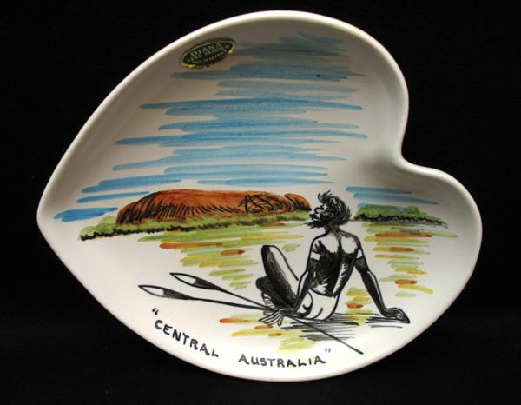
An interesting point is raised by art critic Glenn R. Cooke: " Aboriginal people and their traditional lifestyles had all but disappeared from the state capitals during the 1930s, but as tales of exploration and settlement on the frontiers of Australia's north appeared frequently in popular magazines the image of Aboriginal people took on a distinctly romantic cast."
While Aboriginal people were being literally removed from view a whole enterprise of representing them in a romantic light commenced as if they were being consigned to mythology and the past.
This representation came in many cultural forms.
Aboriginal kitsch

Slide 9
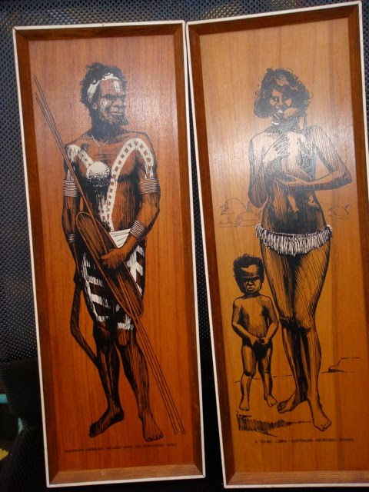
Aboriginal kitsch

Slide 10
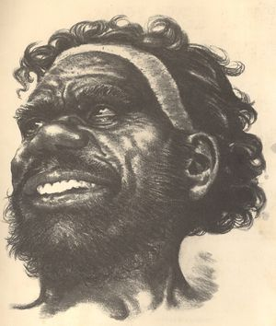
Drawing by Eric Jolliffe

Slide 11
Popular song
'Trumby' by Slim Dusty:
Trumby was a ringer A good one too at that He could rake and ride a twister Throw a rope and fancy plait He could count a line a saddle Track a man lost in the night Trumby was a good boy but he couldn't read or write Trumby was dependable He never took to beer The boss admired him so much One day made him overseer It never went to Trumby's head He didn't boast or skite Trumby was a good boy but he couldn't read or write.
The drought was on the country The grass in short supply The tanks were getting lower and the water holes near dry Cattle started dying And relief was not insight To estimate the losses Trumby couldn't read or write.

Slide 12
He rode around the station pulling cattle from the bog To save them being torn apart by eagles crows and dogs He saw a notice on a tree It wasn't there last night Trumby tried to understand but he couldn't read or write. On bended knee down in the mud Trumby had a drink Swung the reigns and to his horse said "We go home I think" "Tell 'im boss about the sign, 'im read 'im good alright" "One day boss's missus teach 'im Trumby read and write"
Well concern was felt for Trumby He hadn't used his bed Next day beside that muddy hole they found the ringer dead And a piece of tin tied to a tree then caught the boss's eye He read the words of 'Poison Here' And signed by Dogger Bry
Now the stock had never used that hole along that stoney creek And Trumby's bag was empty it has frayed and sprung a leak The dogs were there in hundreds And the dogger in his plight Told the boss he never knew poor Trumby couldn't read or write

Slide 13
Now Trumby was a ringer As solid as a post His skin was black but his heart was white and that’s what mattered most Sometimes I think how sad it is in this world with all its might That a man like Trumby met his death because he couldn't read or write
It is a fascinating song that reflects the chronic incidental racism of the time.
Use of the word boy to describe a man
There seems an imperative to show that Trumby had all sorts or positive characteristics or abilities that we might just assume any workman might have.
“His skin was black but his heart was white and that’s what mattered most”
He is special, like Coonardoo. As such he must be a tragic figure.
It might be argued that 'Trumby' also buys into the mythology that Aborigines are dying out. Trumby stands as a symbol of pre-modern Aboriginality. It also draws a stark relationship between literacy, power and survival.
Compare ‘Trumby’ with 'The Ringer and the Princess‘ by the contemporary singer Graham Connors

Slide 14
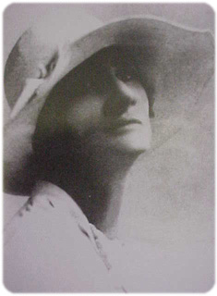
Literature
Three writers are the focus of today's readings. Each of them has a complex relationship with Aboriginality:
Katharine Susannah Prichard
Mudrooroo
Neil Murray
Bios from Austlit
Katharine Susannah Prichard
Katharine Susannah Prichard grew up in Tasmania and Melbourne, and was educated at home until she was fourteen and received a half-scholarship to attend South Melbourne College. Although she matriculated successfully, her mother's illness and the family's poverty made it impossible for her to pursue university studies.
Prichard became a governess in country New South Wales, but returned to Melbourne to teach, and to attend night lectures on literature by Walter Murdoch. In 1908, a year after the suicide of her father, she travelled to London carrying a letter from Alfred Deakin which praised her journalistic skills highly. In London, she worked as a freelance journalist on assignment for the Melbourne Herald , and, following her return to Australia, became the editor of the women's page of the Herald for two years. Five years later, Prichard returned to England to continue her writing career.

Slide 15
In 1919, Prichard married Victoria Cross recipient and Gallipoli veteran, Hugo (Jim) Throssell, and they lived in the outer Perth suburb of Greenmount. For Prichard, literature and politics were always intertwined. Splitting her time between politics and writing, Prichard continued to work on her fiction, while becoming a founding member of the Australian Communist Party in 1920 and a member of its central committee. Her son, Ric Throssell (q.v.), was born in 1922. While she and her sister were travelling overseas in Europe in 1933, Jim Throssell commited suicide.
In 1934, Prichard helped to set up the Australian Writers' League, and was elected federal president the following year. She co-founded the Unemployed Women and Girls' Association in Perth, and, in 1938, established the Modern Women's Club. In the same year, she was one of the founding members of the Western Australian office of the Fellowship of Australian Writers.
Translated into numerous languages, Prichard's novels cover a wide thematic territory, including the colonial period and pioneer experiences in Australia, melodramatic romantic relationships, political ideas, the Australian landscape and environment and Aboriginal culture. In addition to her novels, Prichard also wrote short stories, drama, autobiography and some poetry.
Prichard continued both her political involvement, especially her commitment to the Peace Movement and to socialism, and her writing well into her seventies and eighties, and was nominated for a Nobel Prize for Literature in 1951 by the Western Australian branch of the Fellowship of Australian Writers. Her ashes were scattered in the bush around her Greenmount home. Vic Williams's eulogistic poem ends with the line 'Writer and fighter in one human heart'.

Slide 16
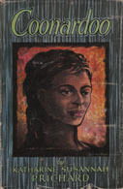
The work we are centrally concerned with is Coonardoo.
First published in 1929, it is a book that has long been acknowledged as a ground breaking work of fiction. It was the first novel to portray an Aboriginal character:
in more than two dimensions
with a psyche
with a sexuality
with humanity
It is also a novel that adopts a radical approach to gender and racial politics. Carole Ferrier claims that "Coonardoo was in its time a powerful contestation of hegemonic attitudes towards Aborigines and black/white relationships” (qtd. in Corbould 1999, p. 415).
Cover of 1956 edition published by Angus & Robertson, Sydney

Slide 17
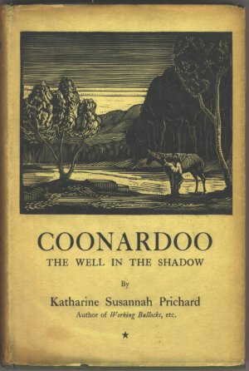
Historian John Hirst makes the following claim:
Like Capricornia, Katharine Prichard's novel Coonardoo (1929), deals with the taboo of sex across the racial divide, in this case on a cattle station in northern Western Australia.
It has a calmer tone and the economy of a Greek tragedy, instead of a saga's sprawl. That the decent white man will not have sex with the Aboriginal woman whom he loves, which leads to the undoing of them both: this is the myth that reconciliation needs. If we followed John Carroll's advice and gave schoolchildren myths rather than history, Coonardoo would be taught in schools. Certainly no historian has brought together so compellingly the land itself and the two peoples who have inhabited it.
Hirst, John. The first XI [The best Australian history books] [online]. Monthly (Melbourne, Vic.), Oct 2006: 48-51.
Cover of first edition published by Jonathan Cape, London, 1929

Slide 18
Coonardoo tells the story of life on Wytaliba, a cattle station in the outback of Western Australia. It deals with the relationship between three central characters:
the station owner, Bessie Watt
her son Hughie
an Aboriginal girl, Coonardoo, whom Mrs Bessie and Hughie both see as special for different reasons.
One night Hughie and Coonardoo have sexual intercourse based on their love for each other which is necessarily fraught and results, perhaps inevitably, in sadness and tragedy.
A number of writers including Clare Corbould have questioned the complacent assumption of Coonardoo's status as a radical text.
“Coonardoo…reinscribes notions of race and racial and gender hierarchies which were dominant in the 1920s” (p.416).
For Corbould Prichard was too influenced by racist stereotypes to ever have written a truly radical text (This raises the question of who can escape their ideologies) .
Vijay Mishra (1987) raises another interesting problem -- that of form. Does the fact that Coonardoo is a romance preclude a radical resolution to the novel?
Mishra also points out that "Coonardoo in 1929 is not the same text as Coonardoo in 1988" -- nor indeed 2014.

Slide 19
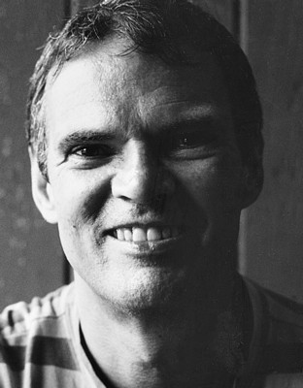
Mudrooroo
Mudrooroo was born at East Cubelling (near Narrogin) in Western Australia. At the age of nine he was placed in a Catholic orphanage, where he lived until he was sixteen. He spent a year in Fremantle Prison, then lived for a time in the home of Mary Durack (q.v.). She was later to write the foreword to his novel, Wild Cat Falling , published in 1965 and acclaimed as the first novel by an indigenous Australian.
After moving to Melbourne in 1958, he travelled in Thailand, Malaysia and India. He spent some years in India as a Buddhist monk, then returned to work at Monash University and study at Melbourne University. In 1988, he changed his name from Colin Johnson to Mudrooroo.
In the 1990s he held a number of academic positions, which often involved teaching courses in Aboriginal literature. These positions included Visiting Associate Professor at Bond University, Lecturer at the University of Queensland, and Tutor and Writer-in-Residence at Murdoch University. Active in promoting Aboriginal culture in the wider community, Mudrooroo co-founded the Aboriginal Writers, Oral Literature and Dramatists' Association with Jack Davis (q.v.), and has also served on the Aboriginal Arts Unit committee of the Australia Council.

Slide 20
In 1996 a controversy arose over Mudrooroo's public identification as an Indigenous Australian. His sister revealed that she had conducted genealogical research that found no trace of Aboriginal ancestry in the family. Extensive debate ensued about the issues of authenticity and what constitutes Aboriginal identity.
After living for a time on Macleay Island off the coast of Brisbane, Queensland, Mudrooroo left Australia in 2001 to pursue further studies in Buddhism.
Mudrooroo is included in this unit because of his status as the first Aboriginal novelist whose place in Australian letters was placed in doubt by the questions about his Aboriginality.
definition of Aboriginal
Why do these questions matter in relation to literature?

Slide 21
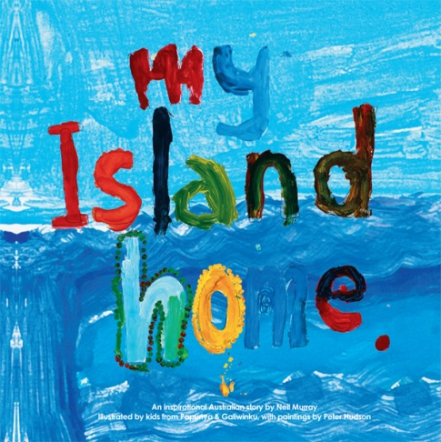
Neil Murray Neil Murray, a singer and songwriter, is well known for his association with the Warumpi Band. One of the founding members of the band in the early 1980s, Murray continued to perform with Warumpi until October 1999 when his solo career demanded a greater time commitment. In addition to songs, Murray's writing has taken the form of poetry, novel and play. Born in Western Victoria, Murray has explored his links with his Scottish ancestry through visits to Scotland. He has worked for many years amongst Aborigines in outback and urban communities and regards Aboriginal cultural heritage as the foundation of Australia's spiritual identity. His commitment to indigenous rights and to the environment is reflected in his writing. Neil Murray's most widely known work is the song 'My Island Home’ which was first recorded by the Warumpi Band in 1986 Play Island Home
Children’s picture book based on Neil Murray’s song & published by One Day Hill, Melbourne, 2010

Slide 22
Murray is a white man who has perhaps avoided the criticisms often directed at white artists because of the efforts he has made to see Aboriginal culture from the inside.
There is a warts and all perspective that he uses in his poems and I wonder whether he has been successful -- if so, is it because we trust him as someone immersed in Aboriginal culture?

