Slide 1
ACL 2009 Australian Literature
Sydney or the Bush

Slide 2
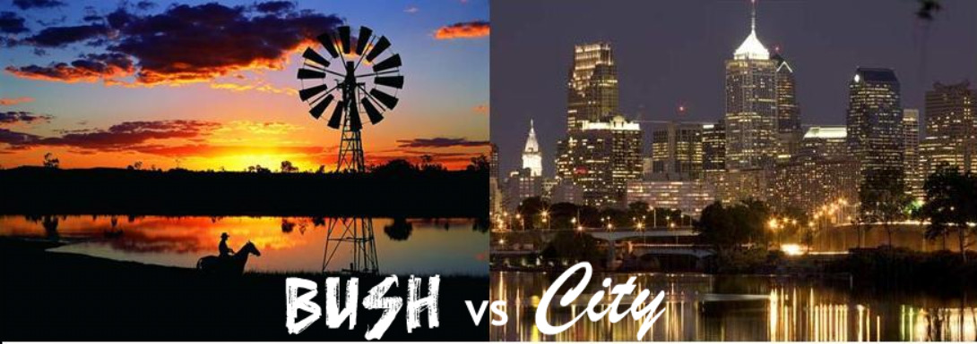
Sydney and the Bush are the two big options in Australia
Sydney (meaning Sydney and by metaphorical extension the bigger cities) was the place of one kind of lifestyle;
the Bush (meaning all those places outside of the cities) was its Other -- and vice versa.
Each has its benefits and drawbacks that sometimes are seen as inversely relational to the other's.
In contemporary Australia the two are seen very much in opposition
Call for a series of oppositions
The tension between Sydney and the bush is one of the long-standing themes and points of conflict in Australian life and literature.

Slide 3
Last week we mentioned A.D. Hope's bleak vision in ‘ Australia ’ (1939)
…She is the last of lands, the emptiest, A woman beyond her change of life, a breast Still tender but within the womb is dry…
And her five cities, like five teeming sores, Each drains her: a vast parasite robber-state Where second-hand Europeans pullulate Timidly on the edge of alien shores...
The texts selected for today are all chosen because of the way they exemplify and or build upon that opposition between the centre and the edge of Australia.

Slide 4
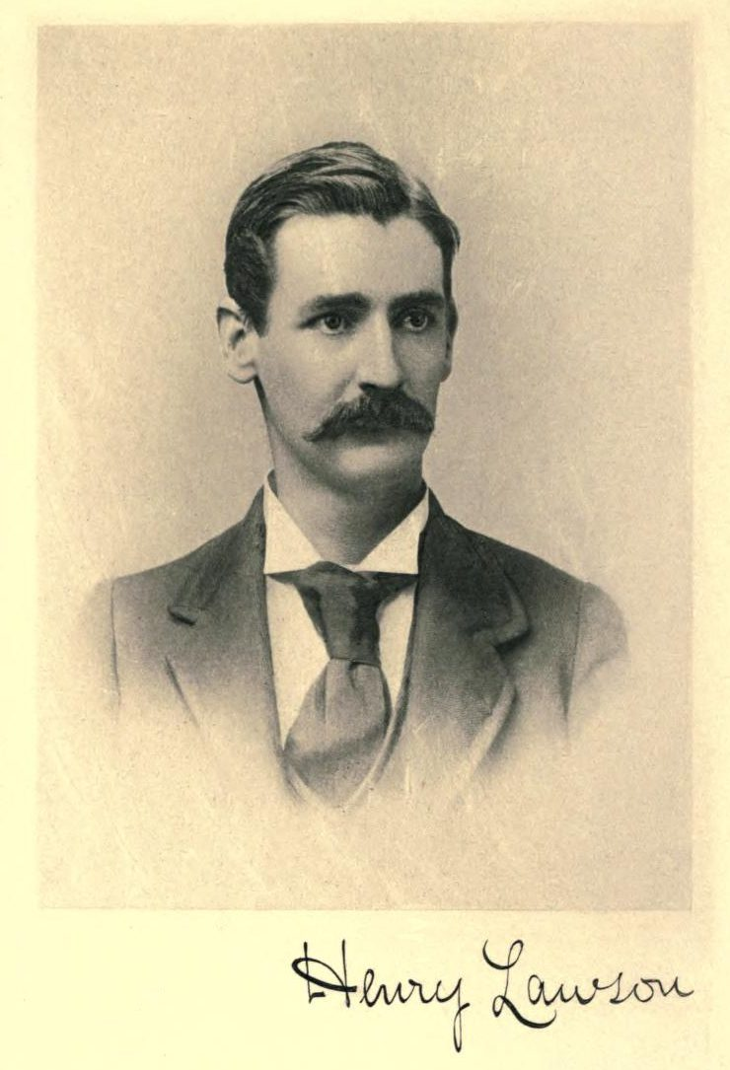
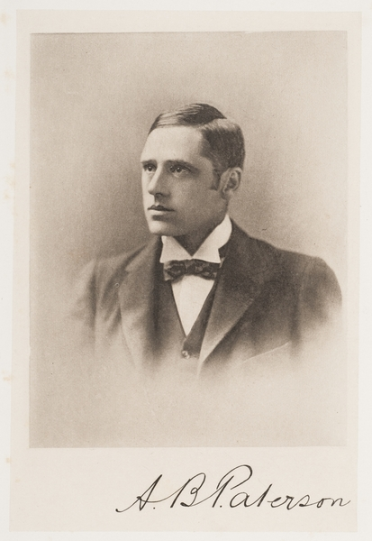
The opposition is well captured by the Lawson Paterson debate carried out in the pages of the Bulletin in 1892.

Slide 5
Read the first exchange: Lawson’s ‘Borderland’ later titled ‘Up the Country’ and Paterson’s reply ‘In Defence of the Bush’ in Lee (ed.) pp. 355-358
The poets asserted the relative virtues of their chosen domains.
Lawson sees the bush as hellish and full of despair whereas Paterson sees it as a place of variation and life – where once one saw drought one will soon see fertility.
Lawson prefers the comforts of the city whereas Paterson sees the poverty and the mean streets.
The exchange is to some extent a fabricated argument designed to sell copy and one made in the spirit of friendship between the poets but it does ask us to confront the question of what is better: Sydney or the Bush.

Slide 6
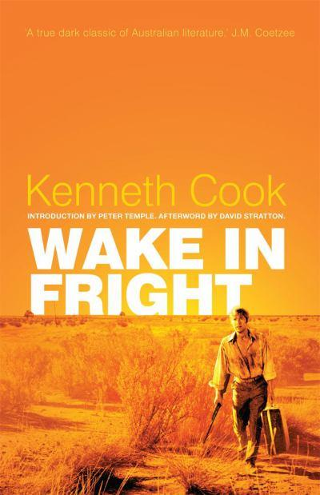
For example, Sydney-bred John Grant in Kenneth Cook’s novel Wake in Fright (1961) is in no doubt. Sydney (or the city) is his goal (p.7)
Like Odysseus trying to get home Grant is confounded at every turn by the people and situations he finds as well as his own arrogance and weakness.
In the discussions of the film adaptation of Wake in Fright a number of classic comparisons are made. Kate Jennings compares Grant to Aeneas from Virgil’s The Aeneid . Kate Jennings on Wake in Fright
Simon Caterson sees a Heart of Darkness comparison.
Indeed it's hard not to see Wake in Fright also as having a classic descent into hell narrative. Peter Temple in his introduction to the edition published by Text sees it so.

Slide 7
One question is whether it fulfils the criteria of a katabatic narrative.
How we see this depends somewhat on when we understand the descent into hell as beginning:
Leaving Sydney? Tiboonda is after all described as a "variation of hell" (p. 8). If this is the beginning of the descent we need to realise that the story finishes with Grant very much stuck in Hell and with no sense of impending escape.
Leaving Tiboonda? Leaving the variation to the pure version? Perhaps. Grant’s return to Tiboonda is one that is based on a change in attitude and perception.
Entering the two up pub? (bottom p. 33) There's much that could suggest that – the frenzy and heat of the game. Grant is being escorted by a Charon like figure (Jock Crawford) who has taken him across the river Styx into Hell. Grant escapes Hell having learnt a lesson – but he is nonetheless far from out of Hell.
Does the ending of the novel give us any ideas about this question?
Right at the end of the novel Grant comes to the conclusion:
‘I can see quite clearly the ingenuity whereby a man may be made mean or great by exactly the same circumstances.’
Which is another way of saying that a life seems to have little in the way of design especially when set in contrast to the vastness of the plain and the universe. Though the book does leave us with a sense that meaning will probably be uncovered – but when and how?

Slide 8
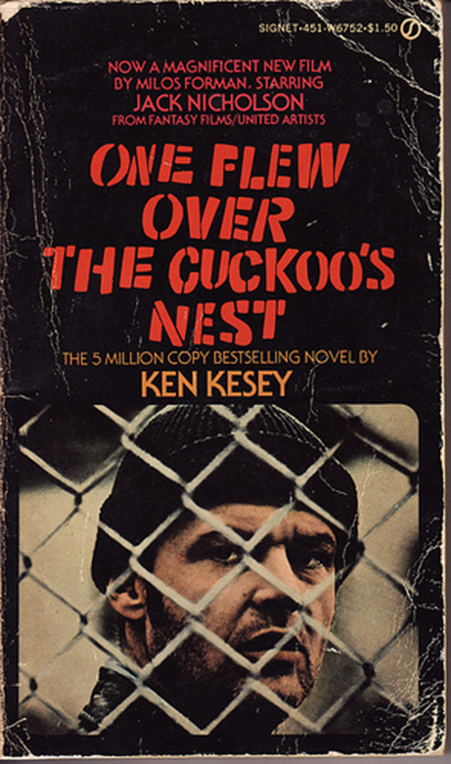
What is significant is that John Grant the heretic with views contrary to the residents of arid inland New South Wales has been stilled – the ending is something akin to the ending of One Flew Over the Cuckoo's Nest (1962) by American author Ken Kesey. Though perhaps Randle McMurphy is more of a Christ figure than John Grant.

Slide 9
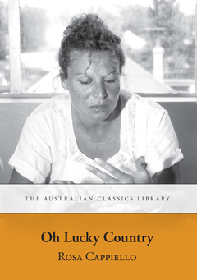
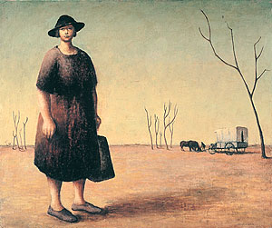
The ending of Wake in Fright brings the novel to a full circle. The plain at night is the inverse of the plain in daylight that we are introduced to at the beginning of the novel and which inspires the opening scene of Ted Kotcheff’s film from 1971
7.30 report story + youtube
This perspective underlines one view of the bush: arid, roasting, relentless, populated by laconic almost-cheerless figures made bitter by their environment. The Bush is Hell.
We could make useful comparisons with a number of the texts we are studying this week:
The opening sentence of Rosa Cappiello’s Oh Lucky Country (1984): ‘The sky here compensates for solitude’
The opening of Henry Lawson’s short story ‘The Drover's Wife' (1892) (read)
The Drover’s Wife 1945
Russell Drysdale
National Gallery of Australia

Slide 10
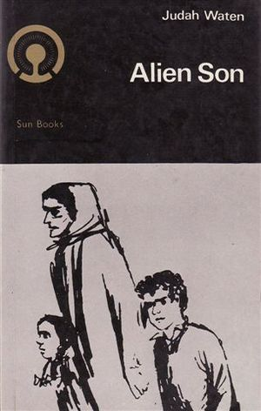
Judah Waten’s ‘To a Country Town’ 1946 (from his fictionalised autobiographical collection of short stories Alien Son 1952) where the Russian Jewish migrant family is in conflict over the wisdom/necessity of going to a bush town. The father sees the economic virtue of the move whereas the mother only sees loss of community. Even when community seems established the story shows how fragile it is. The bush is figured as a place of loneliness and despair.

Slide 11
The argument is not all one way, as we know:
Les Murray ‘Sydney and the Bush’ (1976) read
The bush is the only thing that keeps Australia Australian, the only thing that gives the city's “poor folk a soul”.
Les Murray has long been an advocate of the spiritual superiority of the rural. He sees in ordinary men and women what is lacking in the effete and corrupt city elites.
Les Murray
Photograph by James Croucher
NewsPix

Slide 12
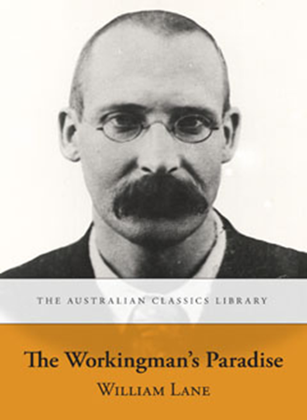
An interesting precursor to all of these texts is the chapter ‘Sweating in the Sydney Slums’ from William Lane 's novel The Workingman's Paradise (1892). Here protagonist Ned Hawkins, a naïve shearer visiting from Queensland, is taken on a tour of the real Sydney by Nellie Lawton, a Sydney dressmaker and ardent socialist appalled by the exploitation of women.
Coral Hull's poem ‘Liverpool’ (1995) is set in order to give the view that the city is Hell: “ liverpool , city of the damned”. But the poem also contains a journey into the suburban Hell of the western suburbs of Sydney . It is a journey poem, a hell poem, but in a sense it is about neither the city nor the bush but about a different space, Suburbia.

