Slide 1
ACL 2009 Australian Literature
Australia as Hell

Slide 2
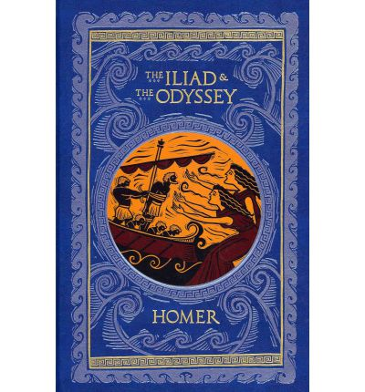
One of the great motifs or themes of world literature is the Journey. Our classic touchstone is Homer and his Iliad and Odyssey, stories of Odysseus's travels to war and his long journey home.
Chaucer’s The Canterbury Tales is the story of a journey in which the pilgrims tell tales to entertain themselves.

Slide 3
Some of the great modern stories are sometimes similarly tales of journeys:
Joseph Conrad’s Heart of Darkness (1902)
T.S. Eliot’s ‘The Lovesong of J. Alfred Prufrock’ (1915)
Comic-book adaptation by Julian Peters

Slide 4
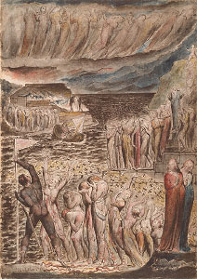
A useful distinction between those texts:
One is a search for something; the other is a stroll apparently without meaning.
One is for a purpose; the other is a kind of tourism -- though it might be argued that Prufrock's journey involves a kind of search.
Many journey narratives are also loaded with the notion of a Quest. So Odysseus travels with a quest to beat his enemies; and then his quest is to get home to his wife Penelope. The quest narrative is the story of a journey with a goal.
One significant journey (and quest) narrative is the descent into hell.
Pre-eminent among these is Dante's Divine Comedy , a long poem in which the poet travels to:
Inferno
Purgatory
Paradise
William Blake illustration to Dante’s Divine Comedy
Inferno, III, 22-83 (1824-6)
National Gallery of Victoria

Slide 5
Dante’s poem is allegorical and speaks to the religious, ethical and moral dimensions of being human.
Dante's descent into Hell is moreover a necessary part of reaching Paradise .
An interesting aspect of Dante's Hell is that people there were punished in ways that related to their sins on Earth. For example, fortune tellers were punished by being physically forced to look backwards for eternity. Hell becomes a place of inversion or upside-downness. See Barron Field's poem 'The Kangaroo’ (1819) in Unit Reader.
Rachel Falconer in Hell in Contemporary Literature (2005)
describes this narrative as katabasis -- a ‘going down'. Stories in which the hero goes down to hell in order to return having developed in some way – spiritually, morally, intellectually.
Katabatic narratives offer writers a positive structure out of which a self is created through adversity.

Slide 6
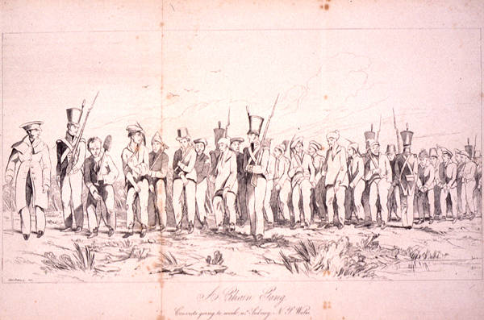
This is an interesting framework to read much of the early Australian material, especially that by Francis MacNamara, better known as Frank the Poet (c.1810–c.1861).
Early Australian writing often involves a journey, a journey that is often involuntary. Most people who came to Australia did so unwillingly and transportation is sometimes seen to be something worse than hanging. It is a journey into despair:
‘Labouring with the Hoe' [read]
Road-gang near Sydney, c.1838
NLA, Canberra
There are many other songs and poems that share a similar sense of regret of leaving behind family and friends and established patterns of life.

Slide 7
‘A Convict's Tour to Hell’ (1839)
This poem is a classic katabatic narrative in which the hero descends into Hell and sees those who have persecuted him suffering for their sins – after which he ascends to Heaven and is made welcome.
Hell is clearly populated by those who have made Frank's life Hell on earth in Australia .
Flogging at Moreton Bay, from William Ross’s pamphlet attacking Capt. Logan’s regime The Fell Tyrant 1836
Mitchell Library, Sydney

Slide 8
Does his narrative have a sense of quest?
Perhaps not. Perhaps it is quite a conservative Christian tale that argues that the oppressed will inherit Heaven in due course. MacNamara's is a narrative of revelation and not of action. He does not fight, struggle or strive but merely observes and learns.
Though maybe this suggestion is undercut by the fact of the dream narrative from which the poet awakens.
Is the message a katabatic one: does the poet create a self through adversity? Just how does this Hell function?
We need to see ambiguity and ambivalence and possibly insincerity in MacNamara's use of Hell.

Slide 9
Read ‘On Leaving Van Diemen's Land’ in Unit Reader
This poem raises the idea that Australia is not all Hell.
This idea is even stronger in an early ballad, ‘Farewell to Your Judges and Juries’
(1815), which also refuses the idea that leaving England or being sent to Australia are in themselves the source of despair. One stanza reads:
To go to a strange country don't grieve me,
Nor leaving old England behind,
It's all for the sake of my Polly, love,
And leaving my parents behind.
Stephen Knight suggests, in The Selling of the Australian Mind, that in “spite of Geoffrey Blainey's memorable summary, distance could be not so much a tyranny as a liberation. Travel to Australia was also travel away from a set of patterns and into a different set of possibilities” (1990, p. 154).
This points to a positive side to exile and leaving old England and raises the question that Hell (like the western suburbs) might not be so much a place as it is a state of mind.

Slide 10
What is Hell?
Literal Abrahamic Hell:
Physically. Hell is a physical place where people go to be punished.
Spiritually. Hell is a place that exists on a spiritual level where our souls go to be punished.
Scientist and Bible teacher, Henry Morris represents one extreme of this debate when he says the Bible plainly teaches that hell is in this earth:
"So far as we can tell from Scripture, the present hell, is somewhere in the heart of the earth itself. It is also called 'the pit' (Isa. 14:9, 15: Ezek. 32:18-21) and 'the abyss' (Rev. 9:2). . . The writers certainly themselves believed hell to be real and geographically 'beneath' the earth's surface. . . To say this is not scientific is to assume science knows much more about the earth's interior than is actually the case. The great 'pit' [hell] would only need to be about 100 miles or less in diameter to contain, with much room to spare, all the forty billion or so people who have ever lived, assuming their 'spiritual' bodies are the same size as their physical bodies. " (Henry M. Morris, The Bible Has the Answer , p. 220)
That is one way of looking at it. It sees Hell as a literal and physical place, much like the one imagined in The Divine Comedy.
The other is to see Hell through a more secular frame.

Slide 11
Secular Hell
Secular Hell is a combination of environmental and human factors.
a physical place on earth of torment, of evil, of never-ending pain and toil.
An emotional or psychological space of torment
The texts we look at certainly paint Australia as a secular hell in all senses:
‘Moreton Bay’ also known as ‘The Convict’s Lament’ (NB this version differs from the one in the Unit Reader and many versions exist)
http://folkstream.com/061.html

Slide 12
Richard White in Inventing Australia (1981) sees Hell as one of the tools used by the ruling class to keep the working class in check.
The equation of Hell with Botany Bay means that the threat of transportation has an equally mollifying effect on the working class.
the idea of Botany Bay as hell on earth was spread for mass consumption in the very cheapest form . . . These books were pandering to a taste for tales of low life in London and of violence in Botany Bay, and were published in the hope of commercial success. Yet they reinforced the moral and economic function of Botany Bay…in the control of working-class crime in Britain (pp. 18-20)
The quite radical suggestion here is that Australia was not quite the hell on earth it was being painted in Britain . This is not to suggest that there was no brutality in the colony but it is to argue that there was also light and progress and a positive side to the journey as mentioned before.

Slide 13
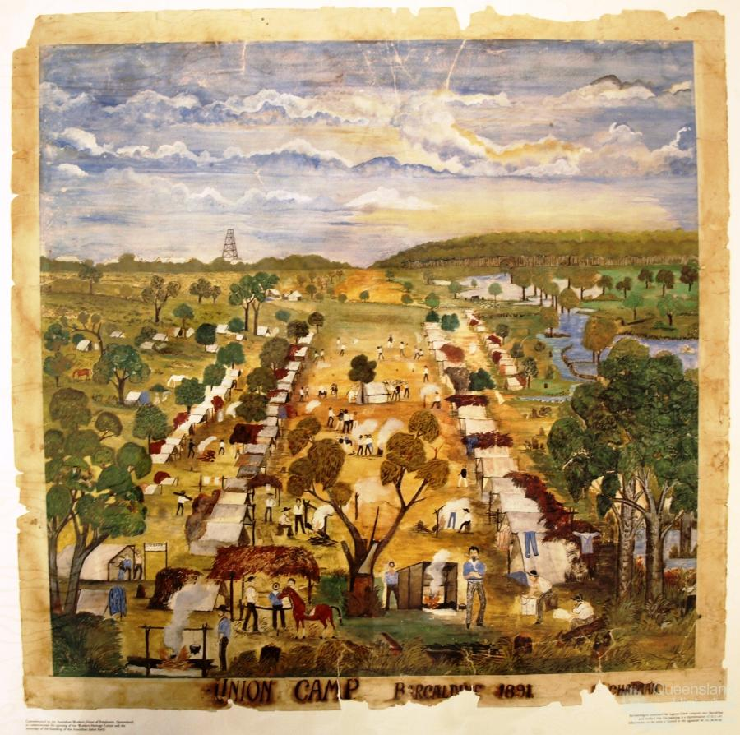
Australia as Paradise
The other side to the argument, then, is that Australia was a Paradise. There is an interesting side to MacNamara's writings that do in fact posit a Paradise to be gained in Australia -- or do they?
Henry Lawson sees a possible paradise in Australia but it is one that is made by people and not given by god. He acknowledges the negatives of exile and transportation but sees a radical political freedom and potential for the displaced.
Henry Lawson, 'Freedom on the Wallaby‘ (1891)
A.D. Hope's 'Australia' (1939) makes the suggestion that behind the apparent Hell, we have inherited a spiritual paradise.
So there are two Australias: one a Hell and the other a Paradise, often depending on which reports one believes.
Union Camp, Barcaldine 1891
by Chapman
John Oxley Library,
State Library of Qld

Slide 14
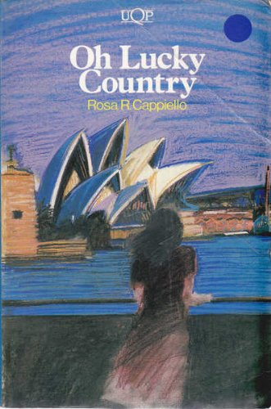
Migrants to Australia were often attracted by the paradisal rhetoric of the Australian government's advertisements.
Admission Impossible
In Rosa Cappiello's Oh Lucky Country (1984) the migrants arrive expecting paradise but are sadly disappointed. Hell and paradise references pepper the opening pages.
We assume some measure of autobiography because the author was dissatisfied with Australia and returned to Italy. She descended into Hell and then returned. Was her trip katabatic?

