Slide 1
ACL 2009
Australian Literature
The Rise and Fall (and Rise?) of Australian Literature

Slide 2
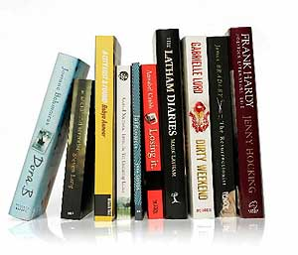
Discussions of the current state of Australian literature are frequently alarmist and usually focus on the prestige area of literary fiction – ‘serious’ or ‘good’ novels for adults (not genre fiction: crime, romance, science-fiction and so on). In his essay ‘The Decline of the Literary Paradigm in Australian Publishing’ Heat, 12, 2006, Mark Davis explores the collapse of what he calls the ‘literary paradigm’. Noting that Australian literary fiction flourished between the 1950s and 1980s, a time of cultural nationalism, Davis discerns recent changes in the values and practices attached to literary culture and places them into a broad context. The cause of the decline includes shifts in ownership, in bookselling practice, in education and the post 1970s rise of neo-liberalism in government, economic deregulation and the globalisation of markets and media channels.
For Davis, NielsonBookscan, which was introduced into Australia in 2000 to track book sales by barcode, is at the forefront of the recent multinational and profit-driven changes to Australian publishing that he argues have led to a reduction in literary fiction . Now publishers decide whether to publish a particular book or author based on previous sales. Genre fiction and non-fiction are at the top of bestseller lists. Whereas the older method of compiling bestseller lists was ‘notoriously filtered’ : subjective, based on anecdote and comprised almost entirely of literary fiction and literary non-fiction.

Slide 3
Davis analysed the output of the top ten publishers. ‘By the early 2000s almost no major Australian publisher was aggressively seeking or promoting new literary fiction at the forefront of their lists’ (Davis 2006, p.94).
Australia has entered a phase in publishing where the literary novel is seen in a negative light, a necessary rump – raising the spectre of its being seen as an unnecessary rump.
Davis’ argument has caused considerable controversy with a number of critics contributing to the debate.
David Carter’s statistical account of Australian literary fiction publishing from 1990 to 2006 suggests that while talk of a crisis in literary fiction publishing might be premature, there are signs that the numbers of new literary titles being published in Australia are falling. Since the end of the 1990s, there is little to suggest a literary publishing sector in expansion. Carter notes the rise of ‘middlebrow’ fiction which is neither popular genre fiction nor niche literary fiction (Carter 2007,p. 244).
‘Boom, bust or business as usual? Literary Fiction Publishing’ Making Books: Contemporary Australian Publishing Edited by David Carter and Anne Galligan, UQP, 2007, pp. 231-246

Slide 4
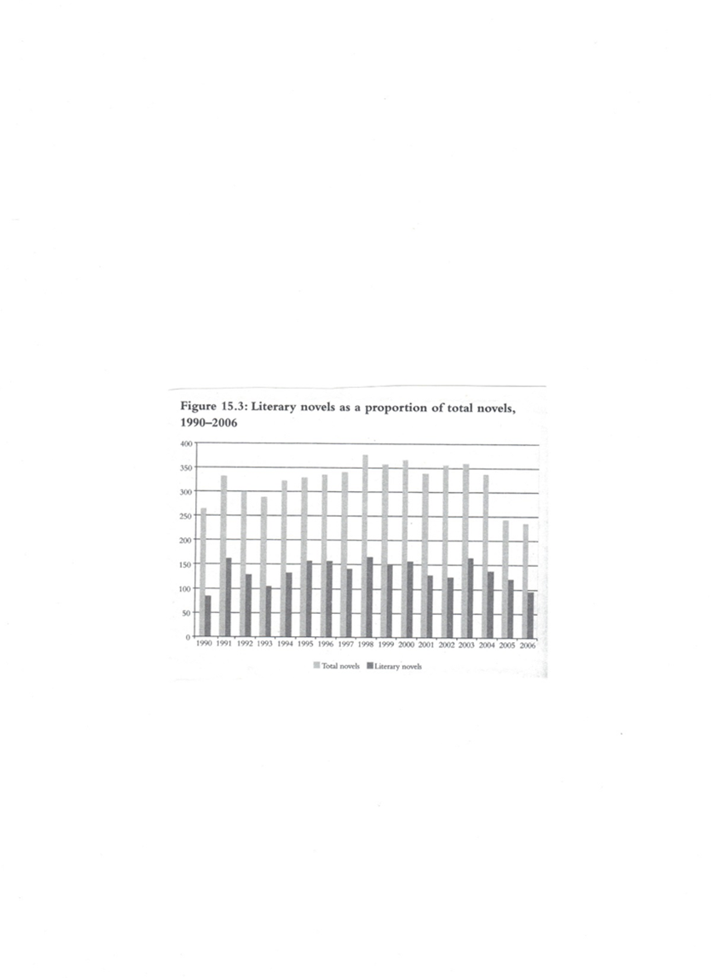
Figure 1
Source: Carter ‘Boom, bust or business
as usual ? Literary Fiction Publishing’ in
Carter & Galligan (eds. ) Making Books
UQP, 2007, p. 238. Data extracted from
AustLit

Slide 5
Including all novels regardless of their publisher, Katherine Bode’s analysis of data suggests a less significant reduction in Australian literary fiction published than Davis’ results. Moreover, unlike Davis’ results which imply a sudden decline from the mid-1990s, Bode’s indicate that the proportion of literary novels has fallen gradually since the 1970s (p. 38). She argues that while large publishers appear to be moving away from Australian literary fiction, these companies do not represent the whole industry (Bode 2010, p. 44).
Bode highlights the recent and continuing growth in biography and autobiography, a form of literature not so easily associated with mass-market consumerism as genre fiction. Figure 2 shows that growth in such titles accelerated at the end of the 1990s, as publication of novels levelled off. Although the rise of biography and autobiography has slowed somewhat in the 2000s, publication continues to increase while that of novels declines (p. 36). Katherine Bode, 'Publishing and Australian Literature: Crisis, Decline or Transformation?' Cultural Studies Review volume 16 number 2 September 2010

Slide 6
Figure 2: Australian novel and auto/biography titles, 1860–2007
(source: Bode 2010, p. 37. Data extracted from AustLit)

Slide 7
Bode concedes that the drop in Australian poetry titles since the mid 1990s seems to support the view that Australia has undergone a shift to an increasingly market driven publishing industry (p. 34).
Bode concludes that Australian literature and publishing are changing. Such change, she argues, is not necessarily positive, but nor should it be automatically considered a crisis (44).
Davis’ prediction that literary fiction will be published either as part of prestige imprints within large houses whose main business lies elsewhere, or through the niche interests of smaller independents has already occurred.
If, as Davis suggests, the Australian literary paradigm is on the decline, what are we to make of the problem?
Is it a problem?
Why?
What does literature give us that other forms of discourse do not?
Does literature limit us in certain ways?
In his book The Burning Library: Our Great Novelists Lost and Found (2012) Geordie Williamson argues that Australian literature has been killed by the various infrastructures that once upheld it. He claims for example, that at universities subjects designated as Australian literature have died out. He makes the familiar argument that the dominance of critical theory since the 1980s has contributed to the end of Australian literature in its earlier guise as cultural nationalism. Williamson does acknowledge present undertakings in academia to uphold the tradition of Australian literature but argues that they have ‘an air of obligation’ surrounding them (p. 6).

Slide 8
Prior to World War II, Australian literature did not exist. Insofar as:
It was not studied at university
It was not seen as a serious publishing category within Australia .
Authors needed to obtain overseas publication to be taken seriously (the cringe?) and to vindicate themselves
As said last week the post World War Two period sees our culture trying to develop and throw off the cringe.
One part of this process was the installation of Australian literature courses in Australian universities.
Public campaigns were made and eventually the first Chair in Australian literature was established at the University of Sydney in 1962.
Leonie Kramer occupied the chair 1968 -89. Interestingly, the first unit she established was a comparative one comparing European classics with Australian texts.
While slightly cringy this response is still better than some other responses from around the same time.

Slide 9
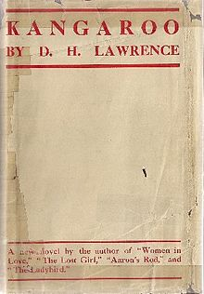
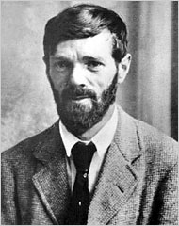
British migrant John Pringle, former editor of the Sydney Morning Herald , and the author of Australian Accent (1958 ) - one of the most perceptive non-fiction books written about Australia – nevertheless stated Kangaroo (1923) by English writer D.H. Lawrence (to which he devoted an entire chapter in his book) was perhaps the only profound work written about our country.
Yet the most famous (or infamous, depending on your point of view) accolade given to Kangaroo was from Englishman J.I.M. Stewart, professor of English at Adelaide University, who, when asked to deliver the inaugural Commonwealth Literary Fund lecture on Australian literature in 1940, said that, as he could find no examples of literature written by Australians, he would instead give a talk on Lawrence's novel Kangaroo.
D.H. Lawrence 1922
Kangaroo (1923), based on Lawrence’s three month visit to Australia

Slide 10

Australian literature was established as a serious university discipline by the late 1970s. The Association for the Study of Australian Literature (established 1978) became quite a powerful representative body in the 1980s.
The struggles to establish Australian literature echo the struggles to establish English literature in England in the 1920s when F.R. Leavis battled to get English authors studied instead of classical Greek and Roman ones.
Is there a general historic law that intellectual culture elevates the ancient and the general above the contemporary and the local?

Slide 11
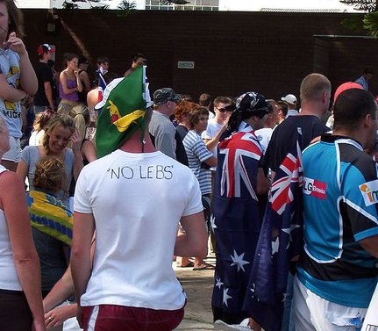
Having established itself as a serious discipline, Australian literature started to wane in the 1990s.
Ozlit courses seemed to collapse around the country
ASAL's membership lost both volume and passion
Literature generally lost its centrality and other cultural forms became legitimate objects of study
Australian became a vexed category.
If ‘Australian' once was a figure of anti-colonial independence that we could wear proudly – it had morphed into a term of exclusion in the shrill voice of Pauline Hanson. The term 'Australian' had generated its underside 'unAustralian'.
Cronulla riots 2005

Slide 12
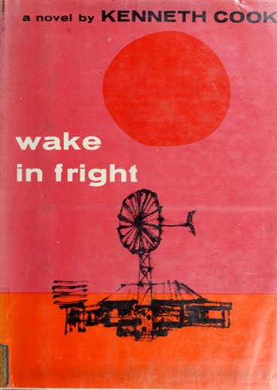
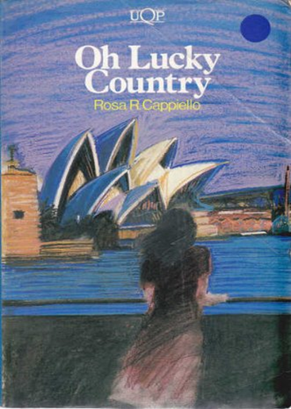

A general mistrust of nationalism and patriotism (except in relation to sport) and the facts of a post-national world combined with the decline of literature saw Australian literature become a difficult category to defend.
What need was there for a body of writing that claimed our independence and isolation when the only way that could be interpreted was as exclusory?
Where you might have on the one hand Australian literature and on the other unAustralian literature. Many of the texts discussed in this unit could be described as unAustralian literature.
1962
1984
2005

Slide 13
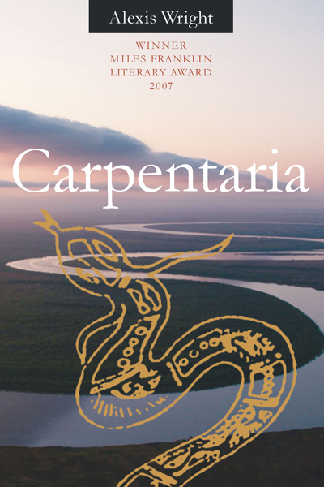
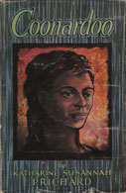
So, in his own contrary way Ian Syson hit upon the idea of establishing a unit in Australian literature, not as a way to resuscitate or defend the Australian legend but to try to see the term Australia as a space in a post-national world.
Contemporary books like Barracuda, Loaded, Dead Europe, The Slap , Carpentaria and Unpolished Gem demonstrate, cross and undercut the border limits of the nation and its legends.
Whereas books like Wake in Fright (1962) and Coonardoo (1929) destabilise the legend from within.

Slide 14
This is also a unit that is deliberately conscious of being established after post-colonialism (a form of literary theory established in the 1970s) in the space and time that David Carter identifies in the very first set of readings in the unit reader.

