Slide 1
ACL 2009 Australian Literature
Lecture 2
Contemporary Australian Literature and the Cultural Cringe

Slide 2
Contemporary Australian Literature and the Cultural Cringe
Contemporary fiction in Australia begins around 1972 and over the past 40 years has not really lost many of its central characteristics:
Belief in the end of history. In both the sense of Francis Fukuyama who proposed that Western liberal democracy represented the end point of humanity’s sociocultural evolution and the postmodern sense that the way in which the past was conceptualized in modernist, linear forms has ended.
Belief in the end of class
Rise of affluence yet the curious and apparently simultaneous rise of alienation and depression
Drug use and sexual liberation and their attendant psychological outcomes -- both positive and negative.

Slide 3
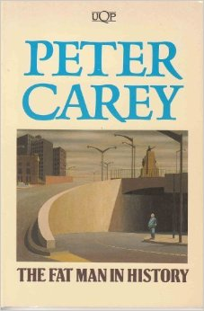
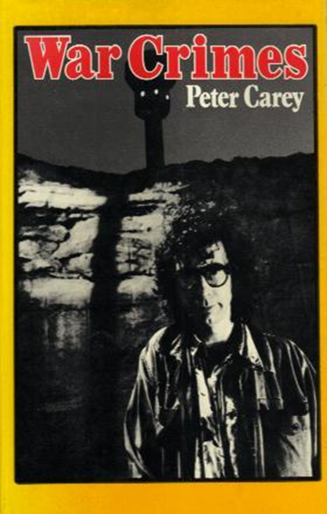
This change in Australia resulted from the demise of a staid, old-fashioned tradition of realism focused on the ‘ordinary' and its revolutionary replacement by a postmodern, extraordinary form of writing (as in the writings of Peter Carey, Michael Wilding and company) allied to a general freeing-up of morality and culture.
1974
1979

Slide 4
One of the factors in this change in the late 1960s and 1970s was the ‘cultural cringe' and the way Australians responded to its terms
Coined by AA Phillips in his essay in Meanjin in 1950 the term ‘cultural cringe' related to a prevalent attitude in Australia that insisted we needed constantly to reference Europe (especially Britain ) as a superior culture to ours.
We were embarrassed about our local attempts to replicate culture as it existed elsewhere.
We craved acceptance from the metropolitan critics of Europe
We were delighted with mild praise.
When we needed expertise we looked overseas.
Phillips also identified the ‘cringe inverted'. The idea that our culture is superior in all aspects: “in the attitude of the Blatant Blatherskite, the God's-Own-country-and-I'm-a-better-man-than-you-are Australian Bore” .
The problem was, if we tried too hard it would only look even more cringeworthy.
The 1960s, then, was a period in which Australian culture engaged with the terms set out by Phillips, in which we tried to extricate ourselves from the cringe – or prove that we were not cringing in the first place.

Slide 5
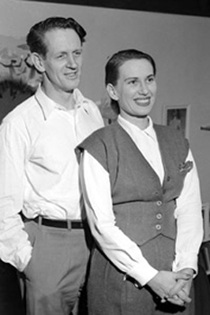
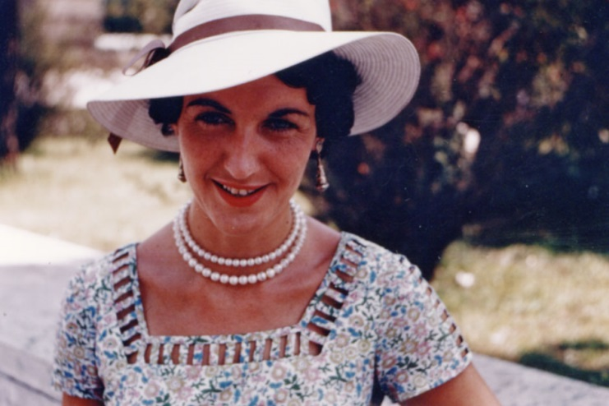
Responses
1.
A stream of writers starts to travel to Europe and elsewhere and write alienated but powerful stories of their disconnection – of the failure of Australia to provide a fertile ground for their art. Writers such as George Johnston, Charmian Clift , Shirley Hazzard and others move away to get some perspective on Australia.
Shirley Hazzard
George Johnston and Charmian Clift

Slide 6
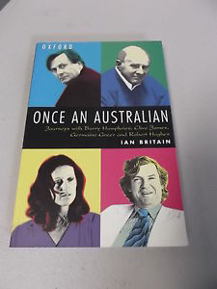
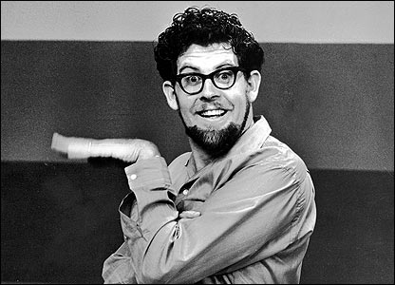
In other fields figures such as Barry Humphries, Clive James, Germaine Greer, Robert Hughes and Rolf Harris find England a better haven for their intellectual projects.

Slide 7
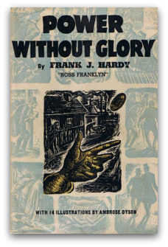
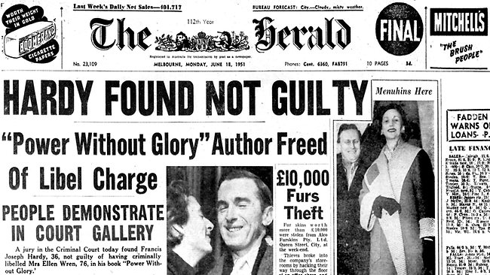
2.
Some of those who stayed tended to overvalue ‘indigenous' Australian cultural forms to the exclusion of the outside world.
Elevation of the bush myth – by both the right and the left of politics
The promotion of cultural nationalism as an important political strategy
The preference of the local without any reference to aesthetic quality as conceived by what Henry Lawson called the ‘cultured critics'
A novel like communist Frank Hardy’s Power Without Glory (1950), a study of corrupt millionaire entrepreneur John Wren, becomes a rallying point for critics in the 1950s despite its flaws and limits.

Slide 8
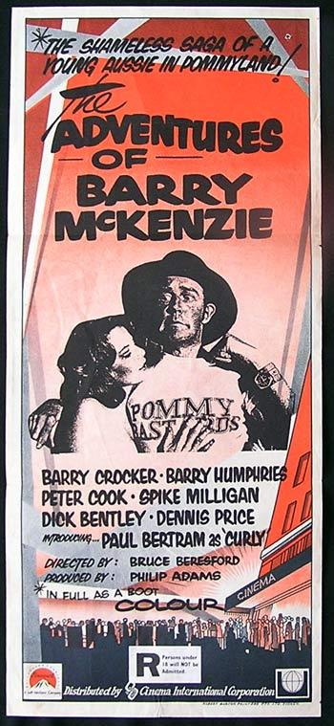
3. Later, in the 1970s, the attitude seemed to be that we should confront the poms with a vulgar and yobboistic attitude. These clips are from Bruce Beresford’s classic film The Adventures of Barry McKenzie (1972)
http://www.youtube.com/watch?v=D4sjyrmSXOw&feature=related
http://www.youtube.com/watch?v=8PfDro1UGUo
It is ironic that Barry Humphries, someone who despised suburbia, was a driving force behind this push.

Slide 9
None of these responses were adequate. None were forms of writing that settled well. They were writings that wore their obsessions too openly – but are nevertheless interesting because of that.
Phillips makes the point that:
the most important development of the last twenty years in Australian writing has been the progress made in the art of being unself-consciously ourselves … I believe that progress will quicken when we articulately realise two facts: that the Cringe is a worse enemy to our cultural development than our isolation, and that the opposite of the Cringe is not the Strut, but a relaxed erectness of carriage. (1950 )

Slide 10
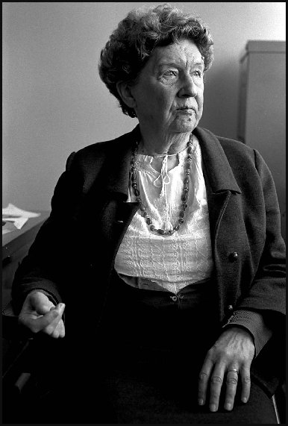
We need to heed writer Christina Stead’s objection to the idea of the cringe. Commenting upon her return to Australia in 1974 after a long absence, she said:
I didn’t notice any great change. Oh, except a ridiculous infection which I expect will go away soon, which I read in the papers about the cultural cringe -- I had no idea what it was. It’s an abject and contemptible expression …when I was here before, there was culture everywhere. (Qtd. in Healy, p. 4)
As Chris Healy states:
Stead perceptively identifies one of the preconditions of the cringe, that anticipating judgement from elsewhere can leave one blind to the everyday world that’s near at hand. Like Stead, AAG [All Australian Graffiti] lived in a world in which it was simply part of commonsense that ‘culture was everywhere’ and that everyday culture was the stuff of their work.
Christina Stead (1974)
Robert McFarlane

Slide 11
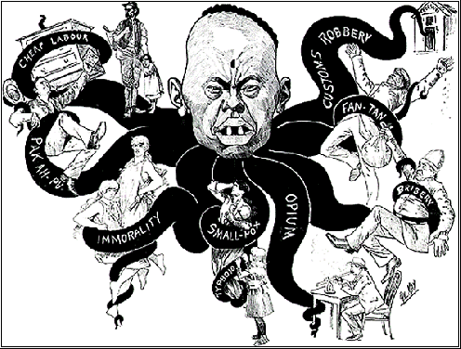
Asia
One of the astounding absences in Australian cultural life in the 1960s was Asia. In this unit we will look at the representation of Asia and Asians to some extent but less than might be desired. But there is very little scope for us to do so in a satisfactory manner. The enormous landmasses and their many millions of people to our north have normally failed to register culturally – except as figures of threat or danger.
Phil May ‘The Mongolian Octopus - his grip on Australia’ (The Bulletin , 21 Aug 1886)

Slide 12
Books like Christos Tsiolkas’ The Slap (2008) and Alice Pung’s Unpolished Gem represent the latest in a long but thin line of serious engagements with Asia as a place that has significance to Australians.
The increase in texts that engage with Asia suggests that we might have successfully moved away from that obsession with Europe that led us to adopt the ‘Cultural Cringe'.
Have we adopted Phillips' "relaxed erectness of carriage”?
Does the poetry of John Forbes overcome the cringe?
Does Tsiolkas overcome it?
Both writers do this, not by inverting the cringe but, in their own way, subverting it. They are comfortable with the fact that Australia exists in a global/international culture and they are quite happy to evaluate things as they find them, unconstrained by the demands of national boundaries and cultural-nationalist politics.
So is an important characteristic of contemporary Australian fiction this comfortable avoidance of the cringe?
How do the writers we explore this week see their position vis-à-vis the rest of the world?
What characterises something of the texts this week is their sense of rootlessness. This gives them the capacity to not be affected by the cringe.

Slide 13
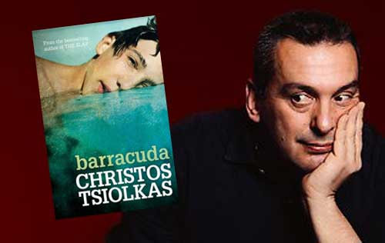
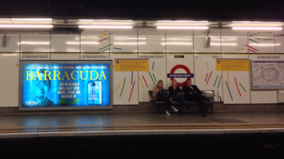
Barracuda (2013)
A story about Danny Kelly, an angry young Australian gay man who is the child of working-class Scottish and Greek parents. Dan feels both pride in and revulsion for his country. The novel critiques strident nationalism and sports-obsessed Australia and draws attention to Australia’s faults. For example, Dehmet believes “We are parochial and narrow-minded and we are racist and ungenerous and we occupy this land illegitimately and we’re toadies to the Poms and servile to the Yanks” (p. 401 ). Barracuda was written after the worldwide success of The Slap during a writing residency in Scotland. It has had a high-profile advertising campaign and generated much interest overseas.
Billboard advertising Barracuda at London tube station

Slide 14
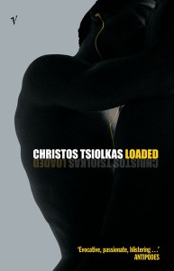
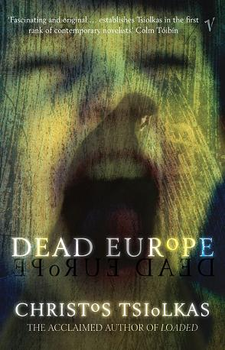
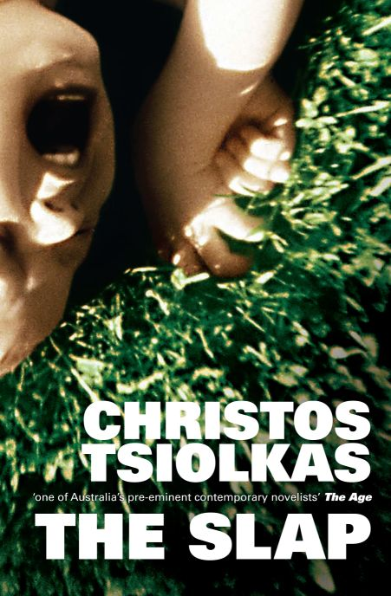
Other novels by Tsiolkas:
In Loaded (1995) the protagonist Ari lives an alienated life in a society in which the long promise of egalitarianism and a fair go for all has been exposed to be a cover-up for the massively unequal distribution of the country’s wealth. The more recent promises of the fragmentary politics of identity expressed through, for example, multiculturalist or Gay Liberation rhetoric are also shown to be empty. Nor is there much useful solidarity in the gay community for a working class homosexual like Ari.
Dead Europe (2005) is about roots being destroyed and there being nowhere to find sanctuary – perhaps Australia is seen as the best of a bad bunch because it is at worst anodyne. But it is hardly something to skite about.
The Slap presents a cosmopolitan Australia in which the outside world is neither superior nor inferior. Australia is big enough to have its own angst and dilemmas.

Slide 15
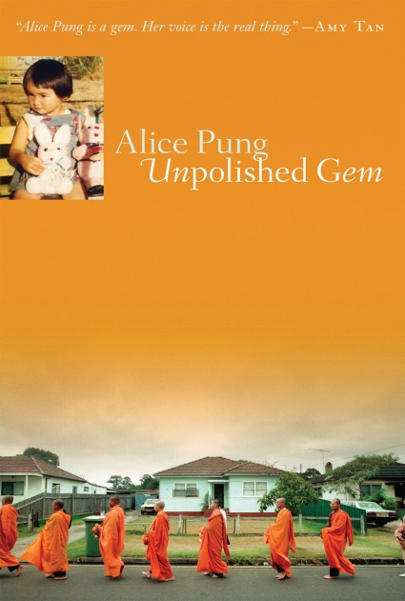
Unpolished Gem (2006)
This memoir is told in the first person by Australian born Alice, the eldest child of Cambodian-Chinese parents who arrived in Melbourne as refugees. Alice and her family face the challenges of making their way in Australian society. It is a story about people who have come to a bizarre world. To some extent it repeats the wonderment of the very early representations but it is also very different from them. It is interesting because it constructs Australia as a paradise – but it is only a paradise to those that do not understand it in the way more long-term residents do (pp. 19 & 26). What is telling about the book however is the sense that the paradise will inevitably dissipate as integration occurs (pp. 20 & 30). The young author’s life and writing was informed by the genre of diasporic Asian women’s life writing.
Alice Pung and her parents, Little Saigon Market, Footscray
Simon Schluter smh.com.au

Slide 16
John Forbes’ 'Anzac Day' (1998) and 'Europe: A Guide for Ken Searle' (1988) are two of Forbes' list poems that compare us to the rest of the world in different tourist contexts. Read ‘Europe: A Guide for Ken Searle’. Similar to Barry McKenzie, the poem’s narrator has innocently come to Europe and is trying to comprehend it. Intimidated by great art, the narrator spends much of his time getting drunk with other Australians. Most of his observations about the countries of Europe are dismissive. The poem satirises Europeans and even more so the type of ocker Australian who goes to Europe but is too ignorant to appreciate what they see. The narrator however is not simply an Aussie who passes out “pissed”. He is clearly familiar with sophisticated terms such as ‘’bella figura ‘‘and ‘’Rococo’’. Forbes has addressed the poem to his friend, the artist Ken Searle so presumably the narrator is Forbes himself. Forbes’ knowledge of the English poetic tradition can be seen in the use of couplets and rhyme usually to humorous effect.

