Slide 1
Poetry and Australian Identities
Dr Rose Lucas

Slide 2
Traditional Colonial Poetry
Banjo Paterson, ‘The Man from Snowy River,’ published in Bulletin 1890
http://www.poetrylibrary.edu.au/poets/paterson-a-b-banjo/the-man-from-snowy-river-0001004
Nascent Australian nationalism. Privileging of masculinity, the life of the bush
Conventional poetic forms – influenced by England

Slide 3
Views of Australian History
‘Civilisation’ or ‘invasion’?
Ties to England vs sense of independent culture, aspiration
‘Advance Australia, Fair,’ http://www.imagesaustralia.com/australiannationalanthem.htm
What is our relationship to the colonial past – pride? Shame?
Judith Wright, ‘Nigger’s Leap, New England’1953
http://www.poemhunter.com/poem/niggers-leap-new-england/
The complex moral position of the white settler Australian

Slide 4
Oodgeroo Noonuccal (Kath Walker)
What has happened to indigenous people, history and culture? Where is that voice?
‘No More Boomerang’ 1985
http://www.poetrylibrary.edu.au/poets/noonuccal-oodgeroo/no-more-boomerang-0719028

Slide 5
Lionel Fogary
‘Mulinjari’ 1983
http://www.poetrylibrary.edu.au/poets/fogarty-lionel/mulinjari-0214062
Anger, negative legacies
The use of indigenous language and customs
Are there problems with using a fundamentally European art form such as poetry? Can poetry operate outside the ideological strictures of its history?

Slide 6
Working People
Poetry can also be a way of speaking for others who might be marginalised by white, european and urban society – such as the working people represented by Murray and Copeland.
Les Murray, ‘Driving through Sawmill Towns’ 1965
Geoff Copeland ‘The luxury of work,’ 2012
http://www.geoffgoodfellow.com/luxury.html

Slide 7
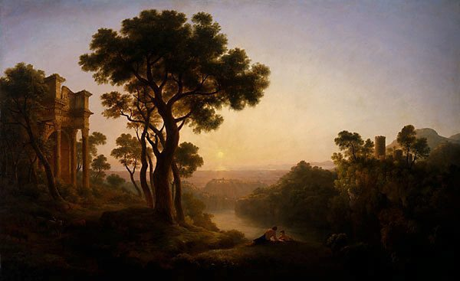
The Landscape
To what extent could European settlers get past the difference in the Australian landscape? John Glover, 1860

Slide 8
The landscape
Is the Australian landscape represented as something fearful, foreign, beautiful?
Dorothea McKellar ‘My Country,’ 1908
http://www.dorotheamackellar.com.au/archive/mycountry.htm
Judith Wright, ‘Train Journey’1953

Slide 9
Multicultural Australia
As the 20th century moved along, with post war migrations and subsequent movements of people from other troubled parts of the world, Australia became far less ‘anglo’ and more multicultural. How do these voices change our perception of Australia and Australianness?
Luca Lesson ‘Yiayia’
http://www.youtube.com/watch?v=dZuTramIn6k
Ania Walwicz, ‘Australia’ http://resources.mhs.vic.edu.au/contextwhosereality/Downloads/australia.pdf

Slide 10
Different kinds of poetry in Australia
Verse novels, eg. Dorothy Porter’s The Monkey’s Mask
Slam poetry (eg Luka Lesson)
Visual/concrete poetry (eg PiO http://www.thing.net/~grist/l&d/thalia/au-pi01.htm
‘Mallee Country,’ http://uwap.uwa.edu.au/static/files/assets/54db55cb/Even_in_the_Dark_Extract.pdf

